Slide 1
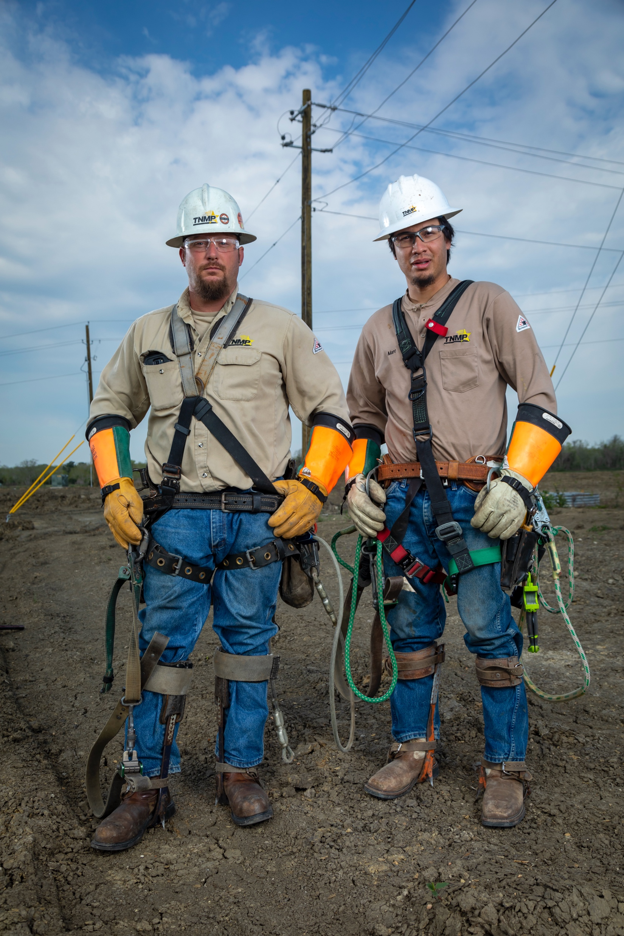

Vegetation Management
Tim Cool
Field Supervisor

Slide 2
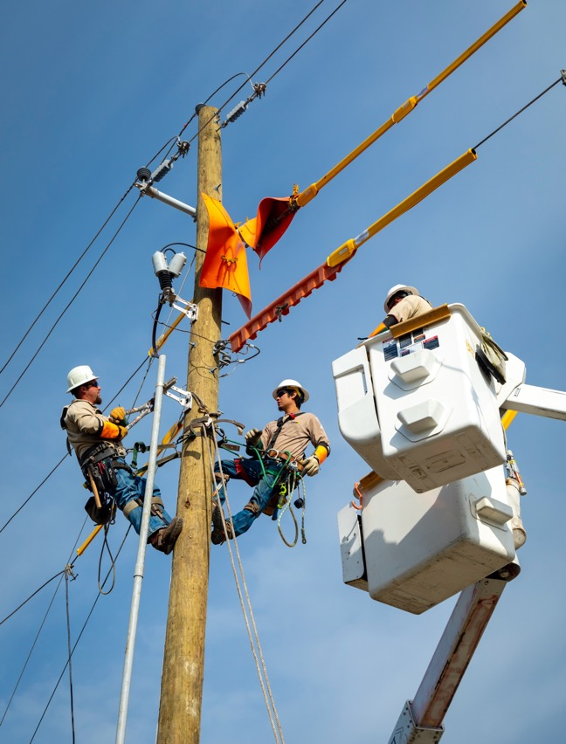
Why do electric utilities prune trees?
FOR SAFETY:
Utility vegetation maintenance reduces electric safety risk to the public by:
  Providing minimum separation between wires and vegetation to eliminate potential electrical contacts.
  Reducing wildfire risk by managing tree/wire conflicts.

Slide 3
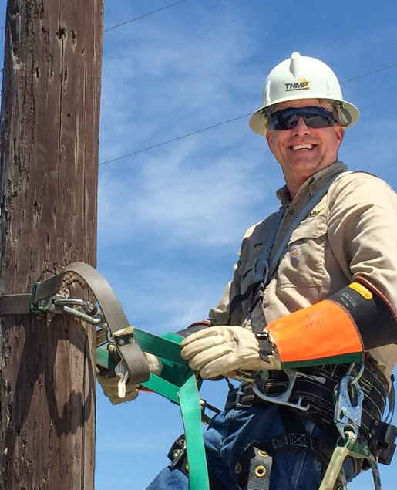
Why do electric utilities prune trees?
FOR RELIABILITY:
Trees that are too close to power lines can interfere with electric service; especially when weather brings wind, rain, lightning, ice, or wet snow. Maintaining power to critical infrastructure and services such as hospitals, nursing homes, police and fire departments, airports, water and sewer pumping stations and traffic signals is paramount.
Utilities can better assure reliability of electric service by:
  Having a preventative maintenance program that includes removing branches, vines and entire trees and brush from electrical equipment and energized conductors.
  Removing vegetation that can potentially cause a safety hazard or an electrical outage when it has the potential to grow or fall into the power lines due to weather or poor tree health.

Slide 4
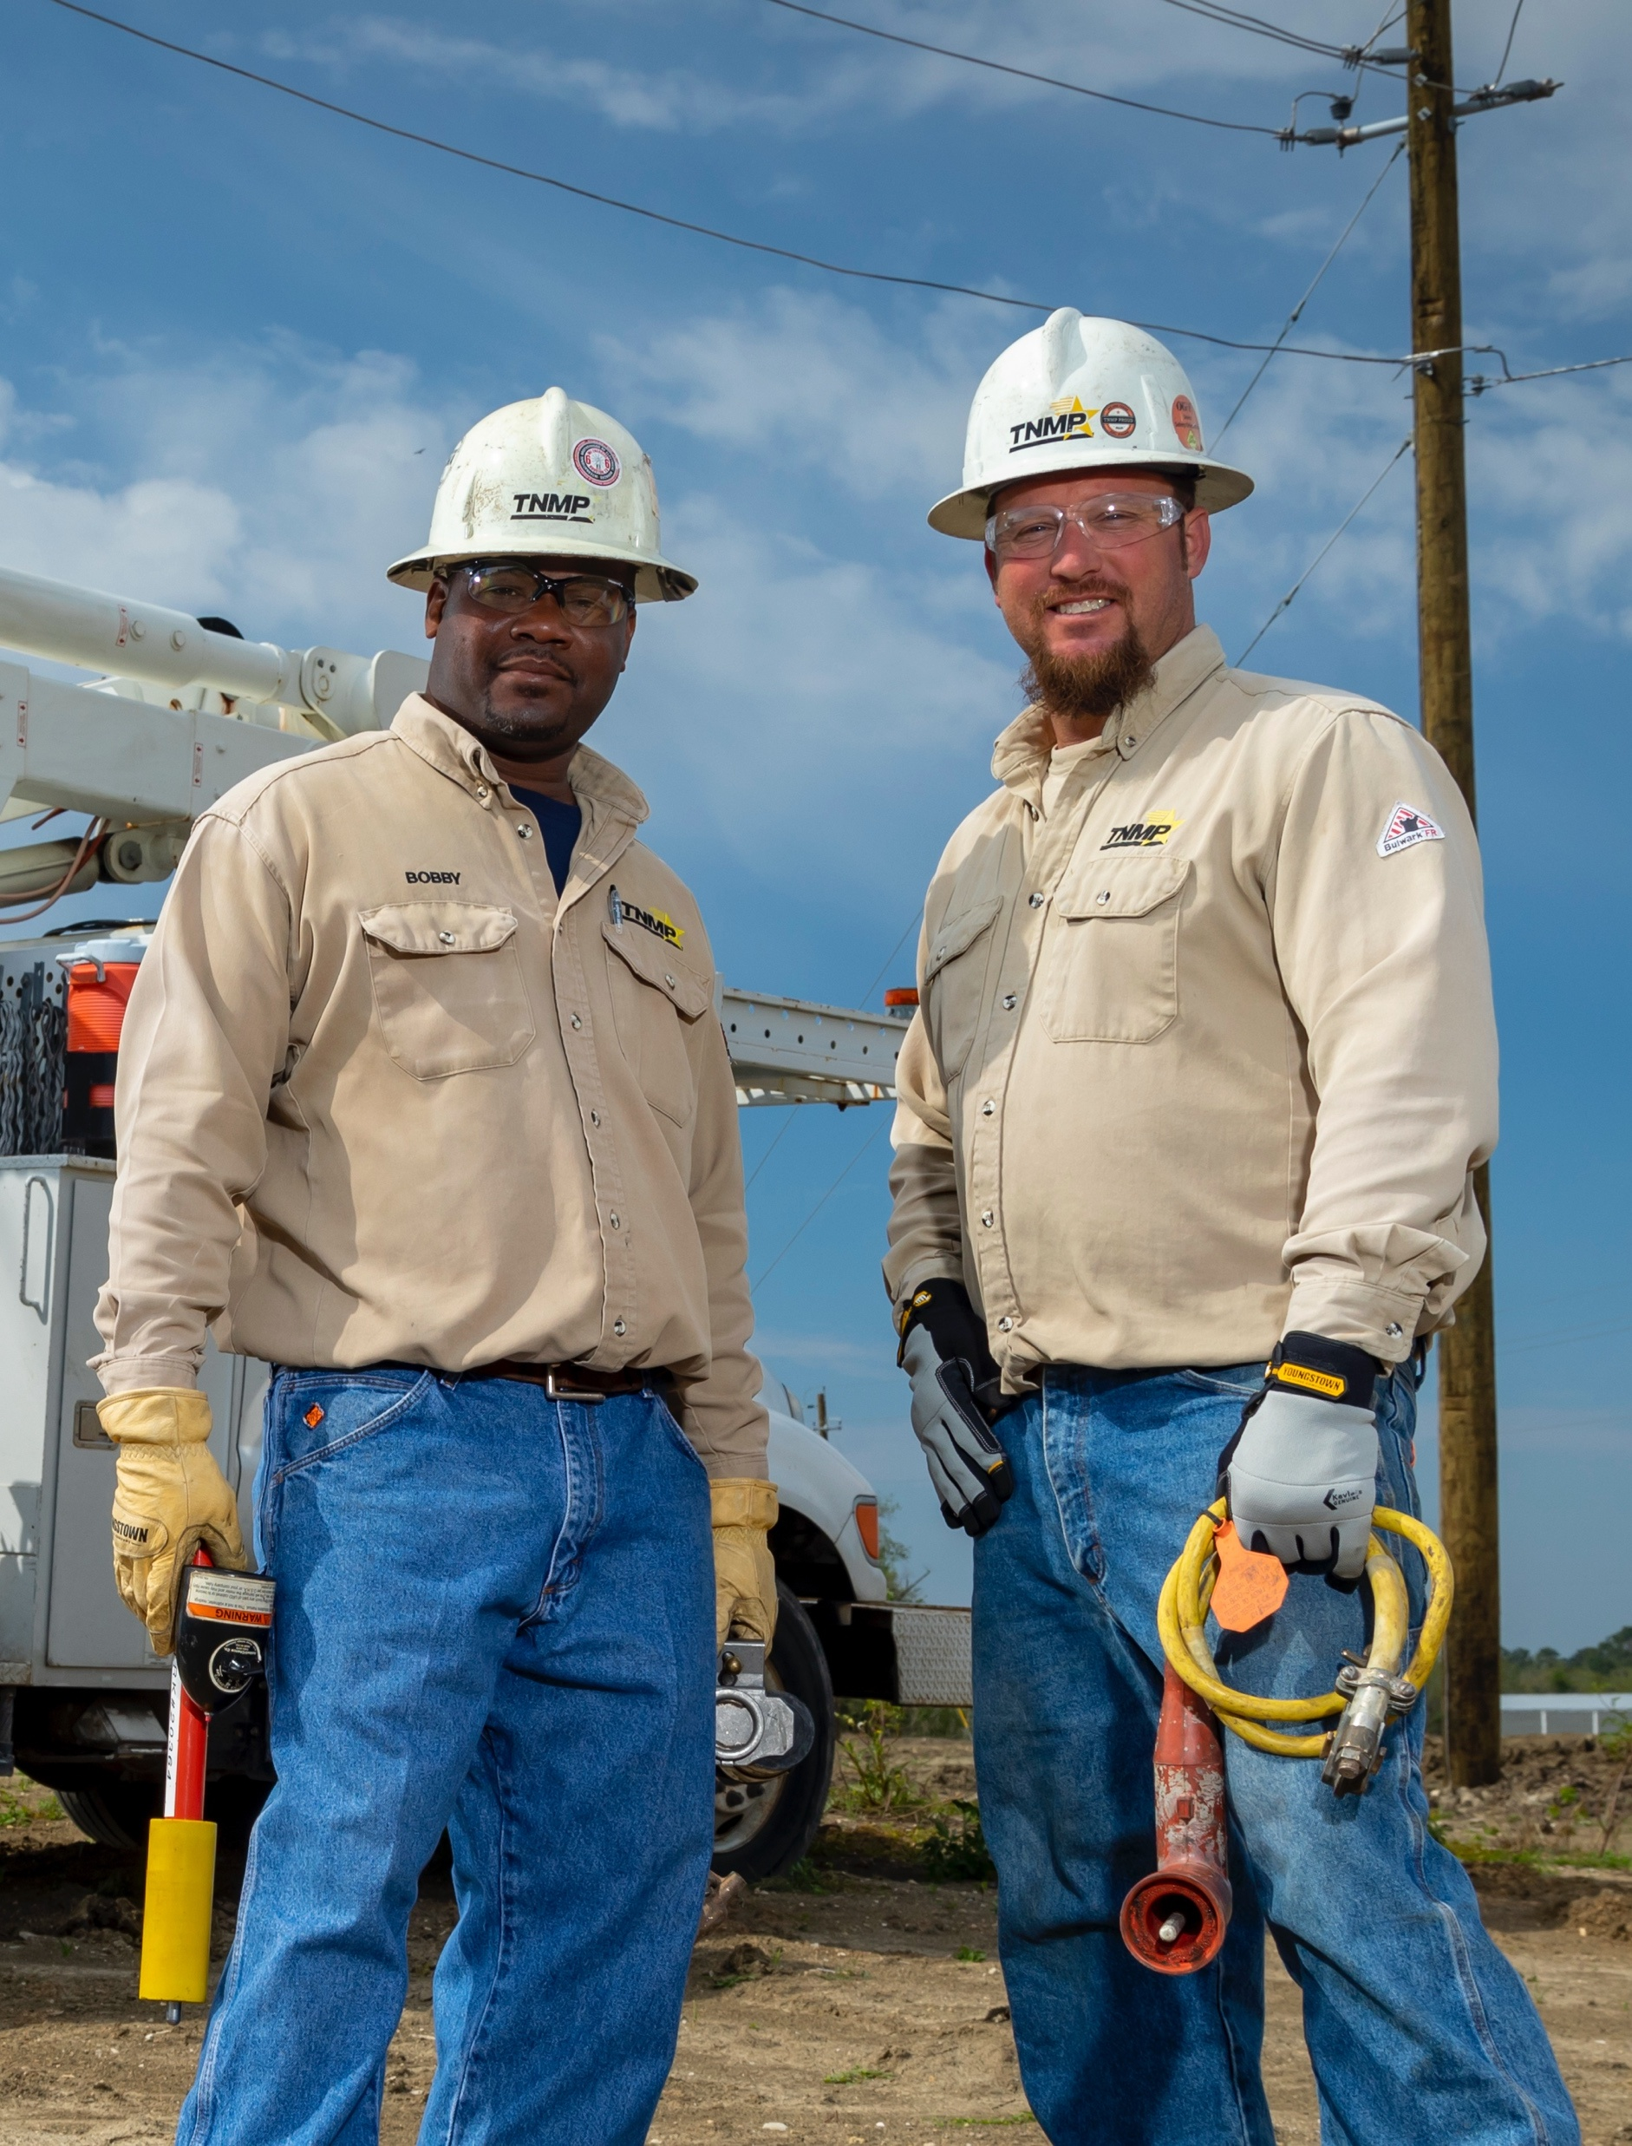
Does the utility follow any pruning standards?
TNMP line clearance pruning contractors follow ANSI A300 standards when performing utility pruning work.
ANSI stands for the American National Standards Institute and ANSI A300 is the generally accepted standard for the utility industry.
ANSI A300 guidelines are endorsed by the International Society of Arboriculture (ISA), and when executed correctly promote directional pruning methods, minimize pruning stress and focus on tree health while obtaining necessary clearance from power lines.

Slide 5
What is Directional Pruning?
Directional pruning includes the removal of branches growing toward the power lines while leaving those that are growing away. It is the most appropriate way to prune trees for electric utility line clearance.
Trees that are pruned in accordance with ANSI A300 Standards will have branches pruned back to a lateral branch that is at least one third the diameter of the branch being removed. Pruning cuts should be made close to the parent or main limb (just beyond the branch collar), and care should be given to avoid flush cuts, stub cuts, and damage to the main limb.

Slide 6
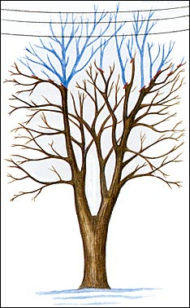
What is Directional Pruning?

Slide 7
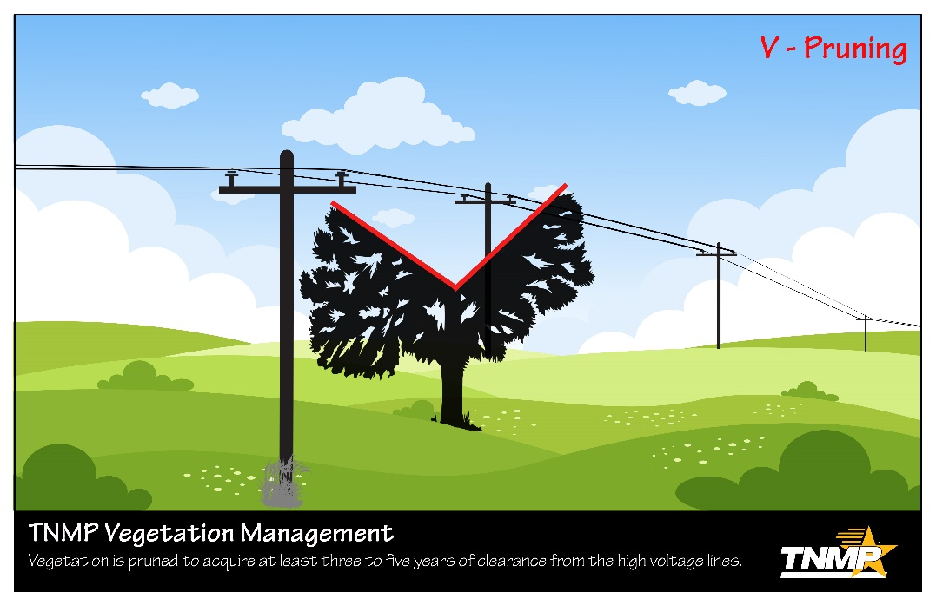
How will a tree look after is directionally pruned?
Trees growing directly under power lines may appear U or V shaped (crown reduction or through-pruning).

Slide 8
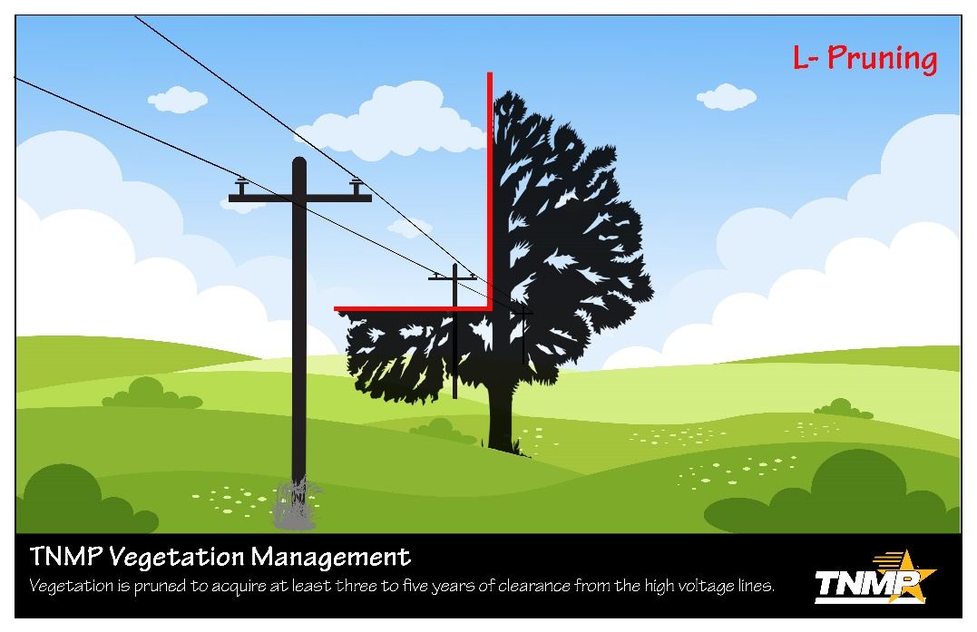
How will a tree look after is directionally pruned?
Trees growing alongside power lines may appear L shaped.

Slide 9
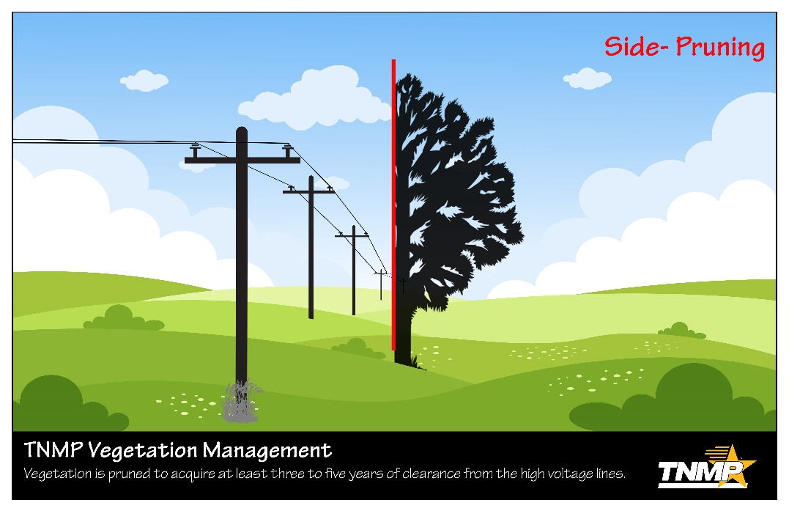
How will a tree look after is directionally pruned?
Or trees growing alongside power lines might have one side completely removed (side pruning).

Slide 10
How will a tree look after is directionally pruned?
The tree may appear misshapen; however, remember that pruning decisions near electric facilities are not performed for aesthetic purposes.
Pruning decisions are made with public safety, system safety, reliability, and tree health in mind.
In general, trees growing near the power lines will never have the potential to grow with a “natural” shape.

Slide 11
How much will be cut from my tree?
Typically, a qualified utility forester or vegetation manager prescribes the amount and type of pruning necessary based on:
  Tree species: growth rate, strong or weak wooded
  Tree Location - proximity of tree to wires and line configuration.
  Tree health or vigor
  Tree structure
  Environmental factors: Wind direction, available water, etc.
  Power line voltage–higher voltages require greater clearance
  Some species require more aggressive clearance requirements (Willow, China Berry, Tallow Tree…etc)

Slide 12
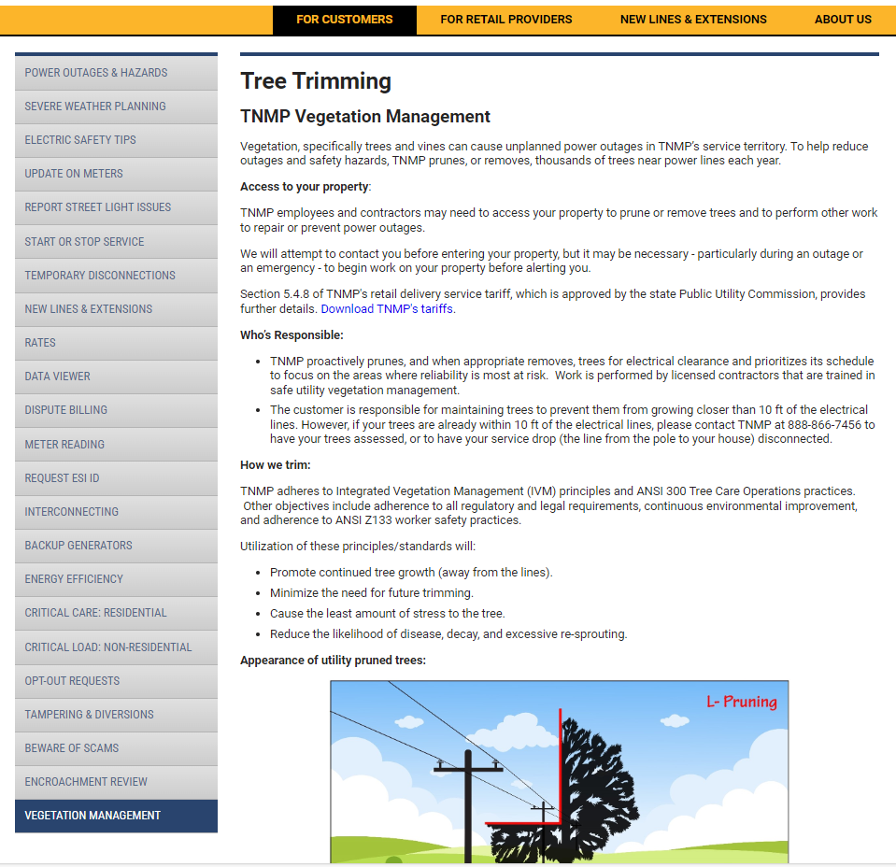
Tnmp.com

Slide 13
Helpful Links
UAA – Utility Arborist Association
http://www.utilityarborist.org
ISA – International Society of Arboriculture
http://www.isa-arbor.com
ANSI A300 Pruning Standard (Pruning of Trees) - http://www.ansi.org/

Slide 14
Tree / Power line contact videos
Large tree burning on Primary
http://www.youtube.com/watch?v=84zSwjNNo3k
Limb tracking on primary
http://www.youtube.com/watch?v=aoeTTbgCIfY

Slide 15
Final Thought
One thing I would like to leave you with is that communication is key. Good communication between the utility and property owners ensures there are no surprises, and clears the path for safe, reliable electric service.

Slide 16
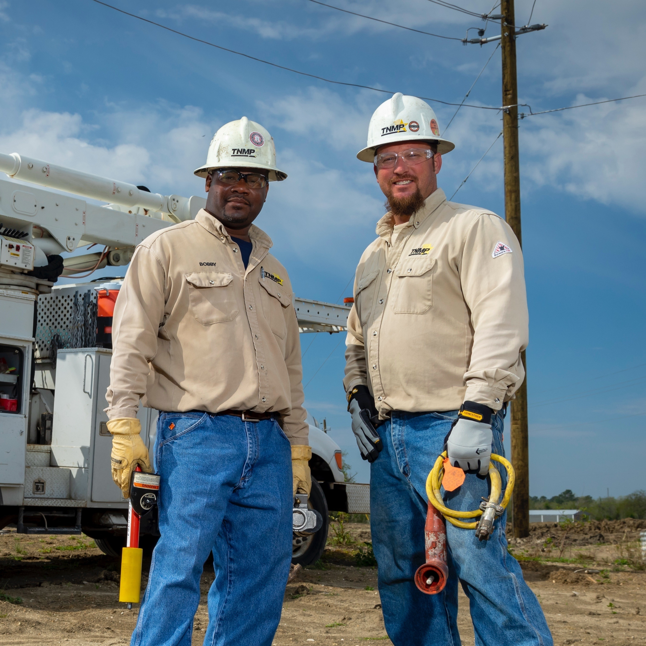
Questions?

