Slide 1


REP Portal Enhancements
Janet Gorman
Business Application Specialist

Slide 2
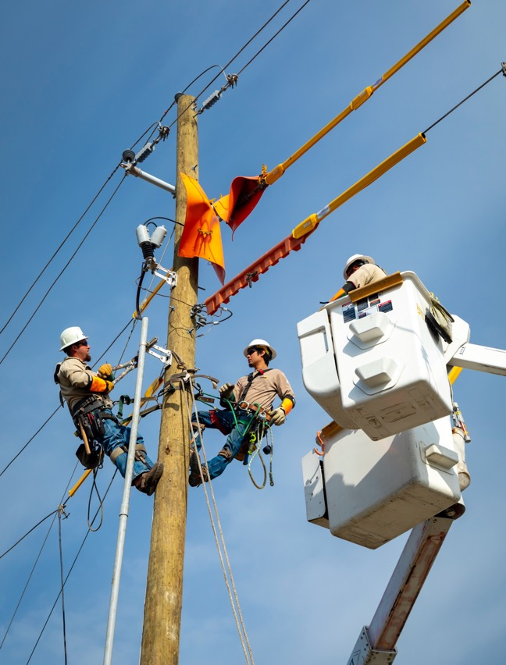
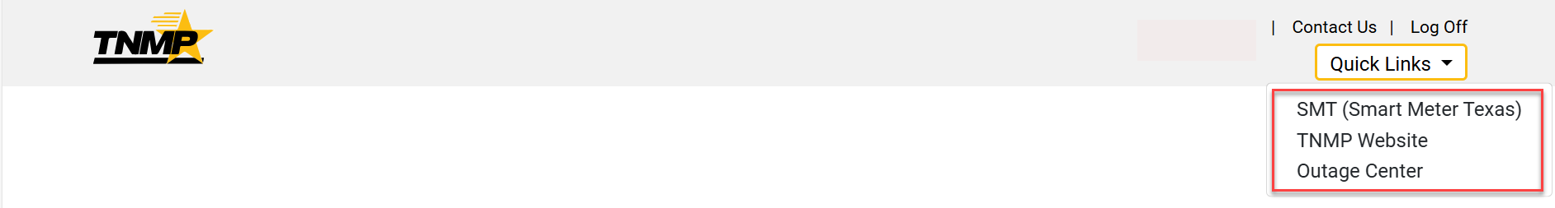
Updates to the REP Portal
          Quick links added to the toolbar for:
            Smart Meter Texas
            TNMP Website
            TNMP Outage Center
              Outage Map
              Report an Outage

Slide 3
Premise Search
  Premise Search by:
    ESI ID
    Meter Number
    Address
  Premise Information
  Usage Data*650*814*867*810 Transactions
    Immediate View without horizontal scroll
    Export to excel functionality

Slide 4
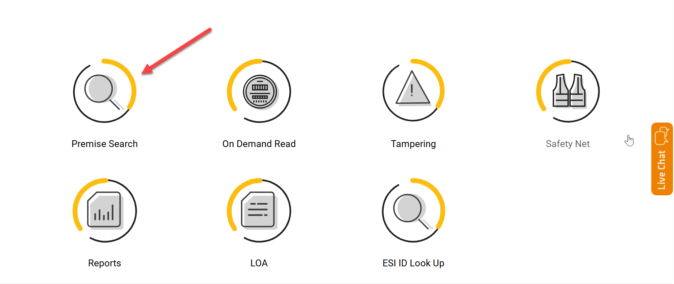
Premise Search

Slide 5
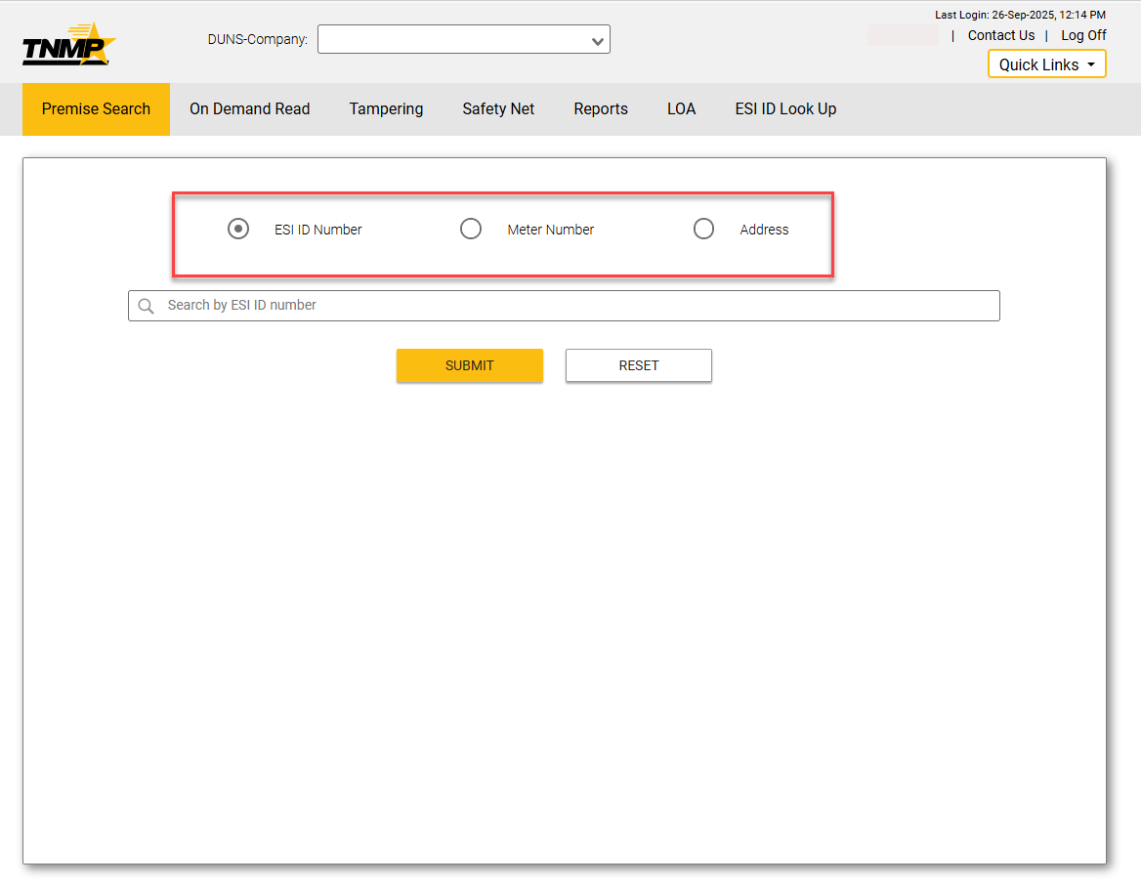
Premise Search

Slide 6
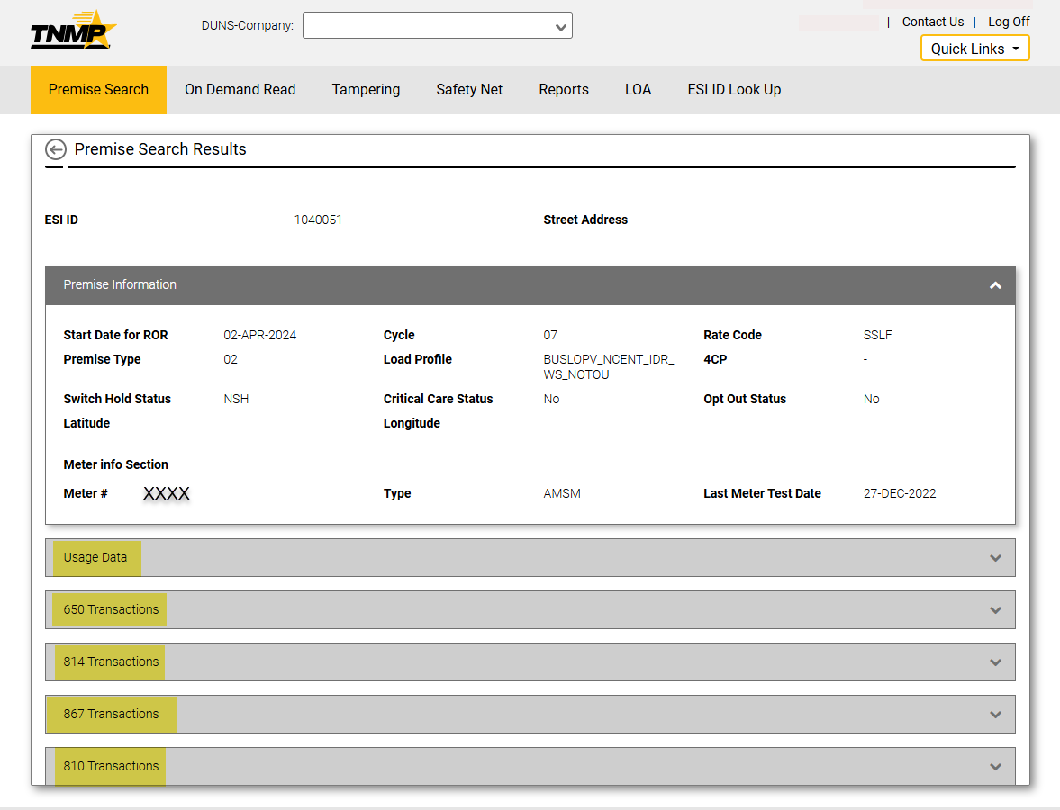
Premise Search

Slide 7
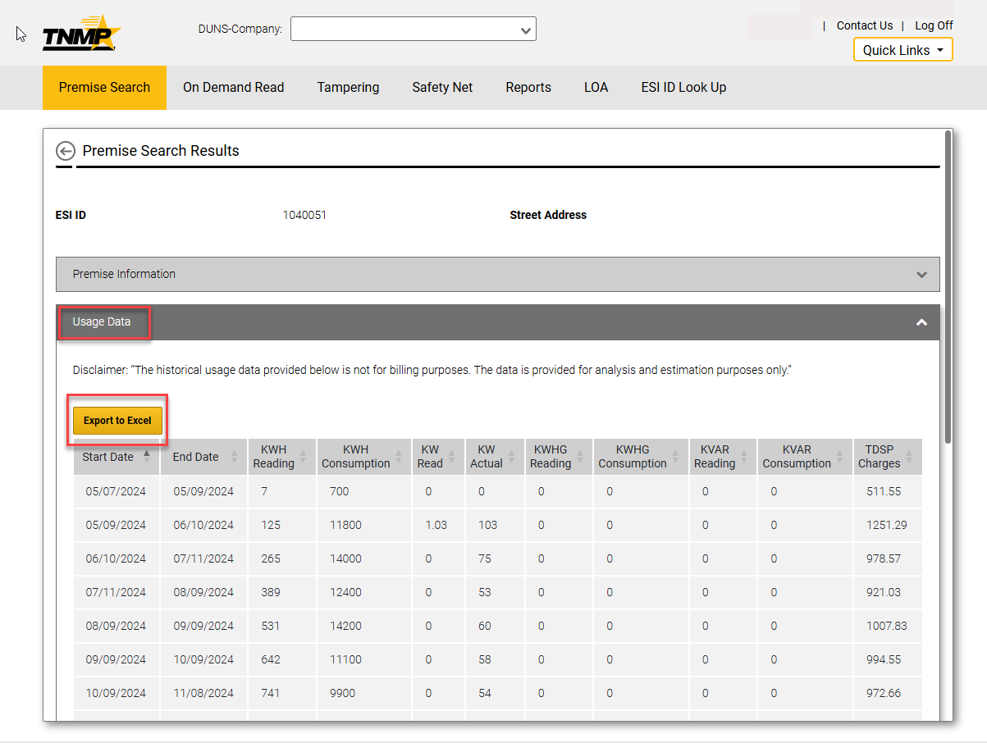
Usage Data

Slide 8
LOA Process
  Cumbersome validations for LOA process removed
    Old process validated ESI ID, Street Name, City, State, Zip & Last Name
    Current Process validates ESI ID & Last Name only
  LOA process updated to allow a manual entry or upload a spreadsheet

Slide 9
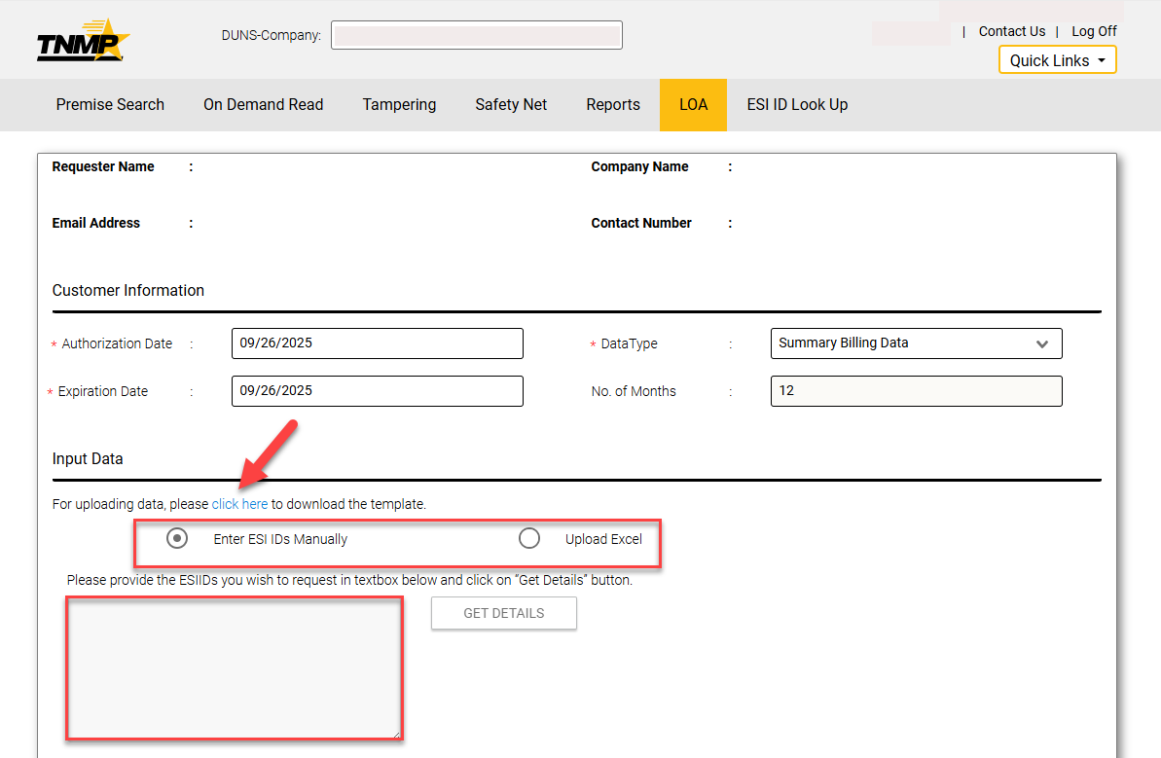
LOA Process

Slide 10
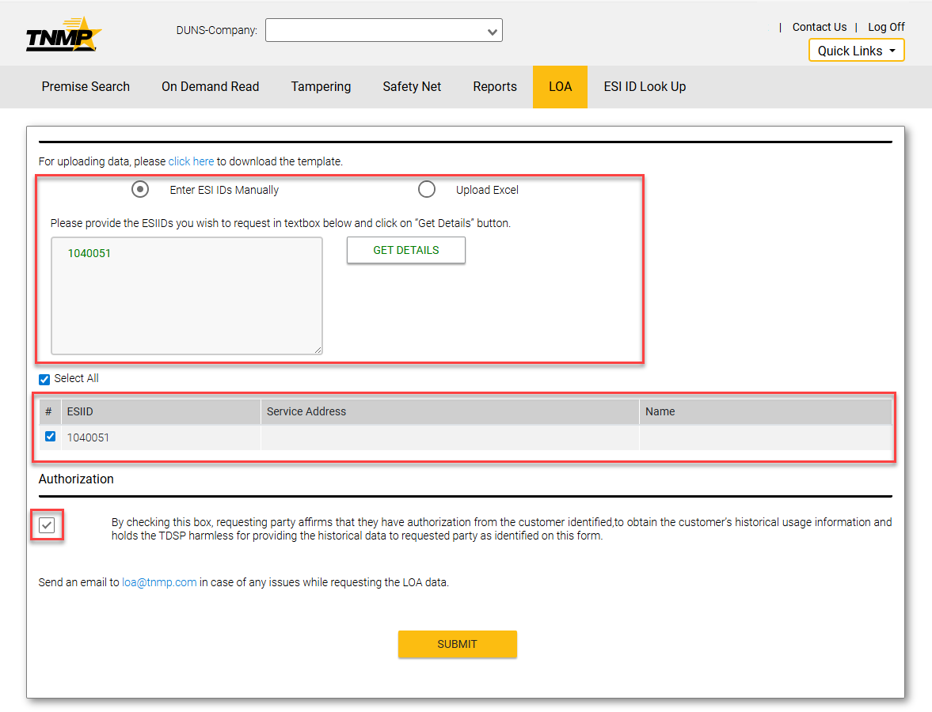
LOA Process

Slide 11
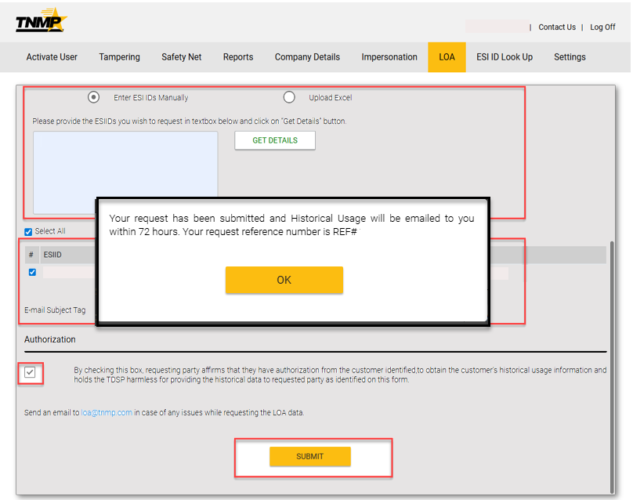
LOA Process

Slide 12

Chat Support
Addition of Chat functionality
      LINK found on our portal
      Available Monday - Friday
    8:30 AM – 4:30 PM

Slide 13
Additional Updates
      SafetyNet Manual Entry
        Nov 1st 2025
      Consumption Graphs
        Jan 1st 2026

Slide 14

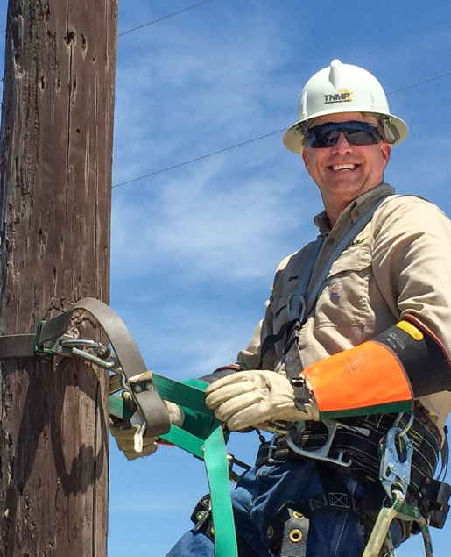


Questions?
MPRelations@tnmp.com
LOA@tnmp.com

