Slide 1
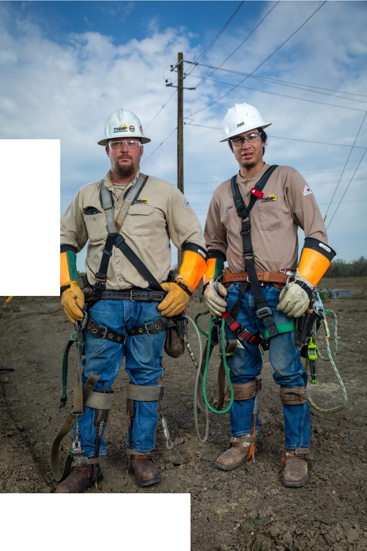

Legislative Update
Ben Utley
Government Affairs

Slide 2
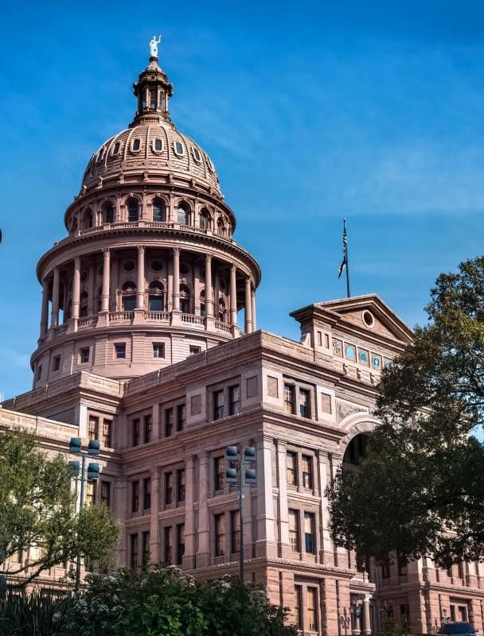
89th Legislative Session
Adjourned Sine Die on June 2, 2025
Over 9,000 bills filed
~14% passage rate
Key Topics included School Choice, Property Tax Relief, Public Safety, Water Infrastructure, and Electric Infrastructure

Slide 3
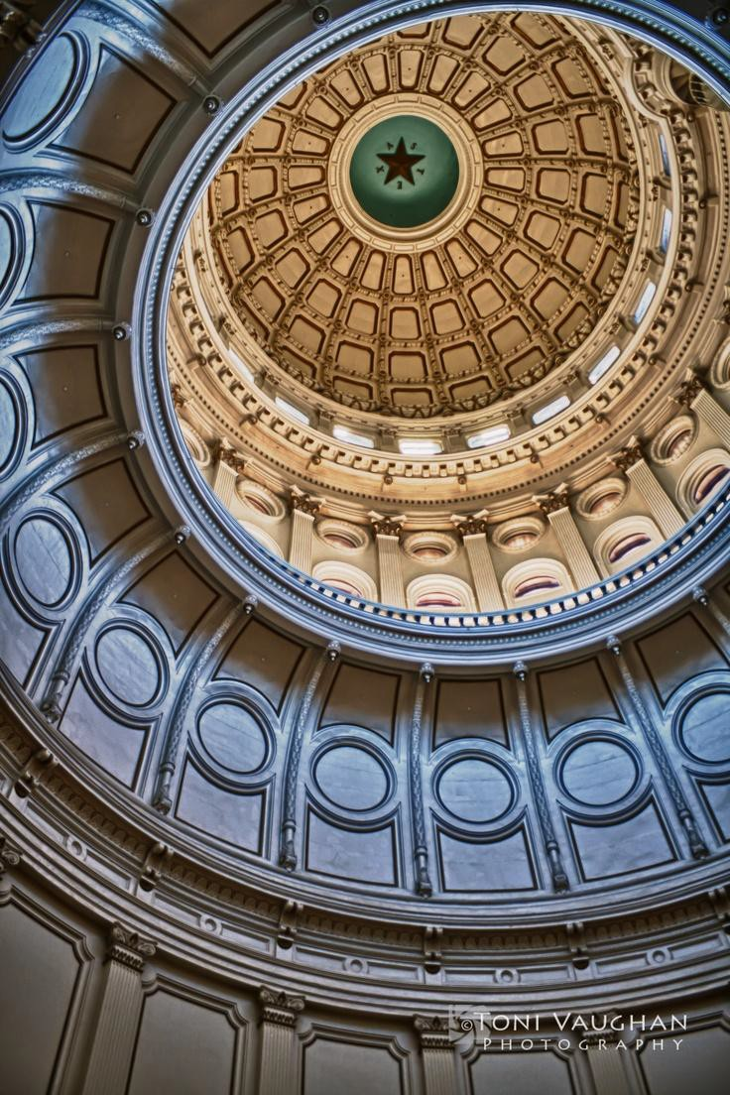
Texas Sized Growth
SB 6 – Large Load Interconnection
Requirements for new large loads (>75 MW)
Focused on load forecasting and grid
reliability
HB 5247 – Alternative Cost Recovery
Aimed at expediting Permian Basin
Reliability Plan
Allows certain utilities to file a single annual proceeding to adjust rates on a system wide basis
Expires in 2035

Slide 4
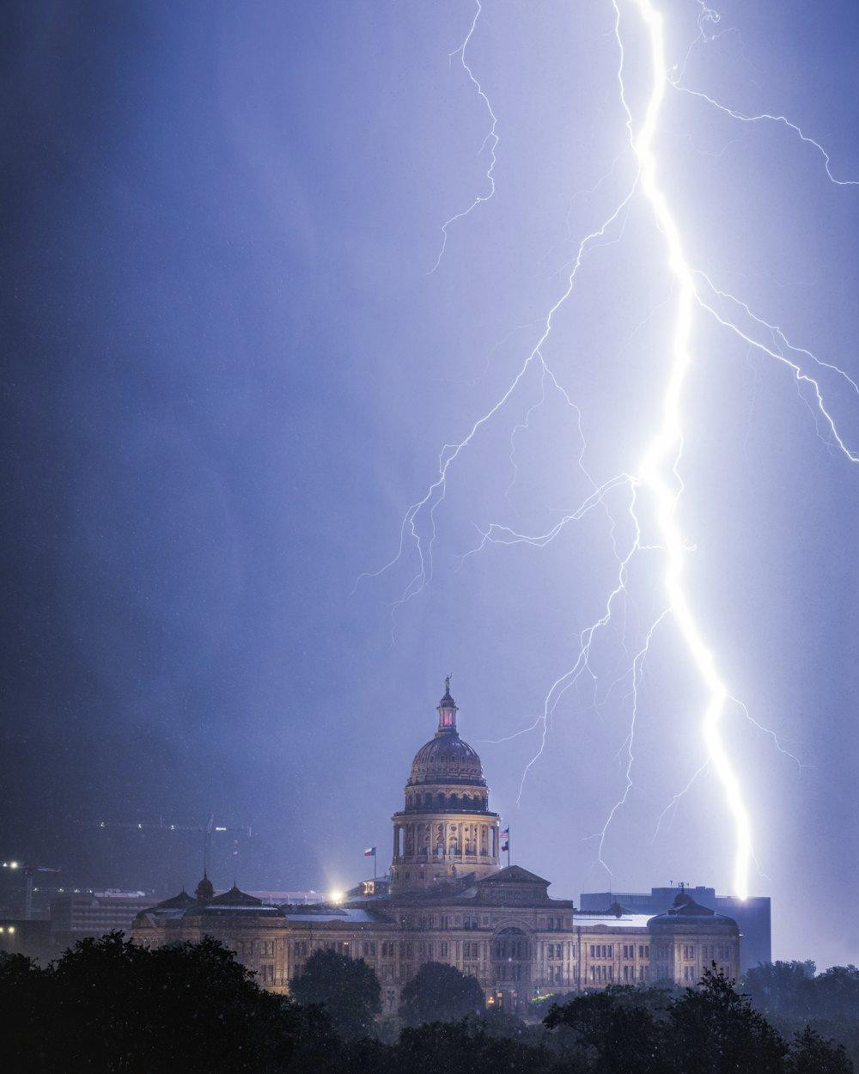
Wildfire and Storm Mitigation
HB 145 – Wildfire Mitigation Plans
Requires utilities to file a Wildfire Mitigation Plan with PUCT
Provides liability protection for utilities in compliance with their plan
Increases utilities’ ability to self-insure
SB 1789 – Pole Standards
Requires the PUCT to set structural integrity standards
Disallows ROE for repairing damaged poles that did not meet standards
HB 144 – Pole Inspection Plans
Requires utilities to file a distribution pole inspection plan with PUCT
Utilities must submit an annual update on progress
SB 1963 – Storm Securitization
Allows utilities to securitize storm restoration costs exceeding $50 million

Slide 5
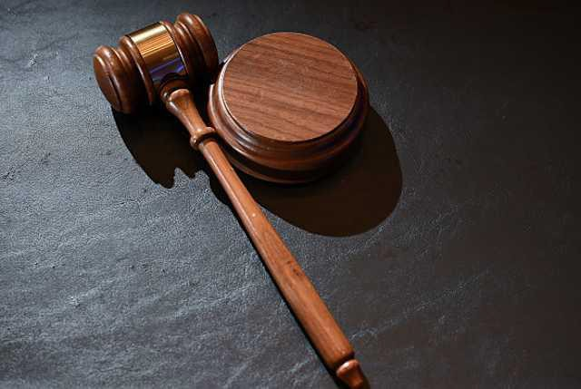
Special Sessions
Governor Abbott Called two Special Sessions on topics including:
Redistricting
Flood Response and Communication
THC Regulation
Property Taxes
The second Special Session ended on September 4, 2025

Slide 6
Questions?

