Slide 1
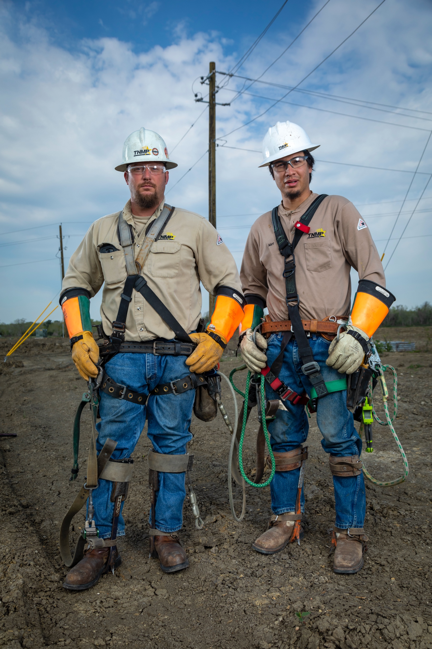

Engineering and Real Time Operations
Chris Gerety
Vice President – Tech Services and System Reliability

Slide 2
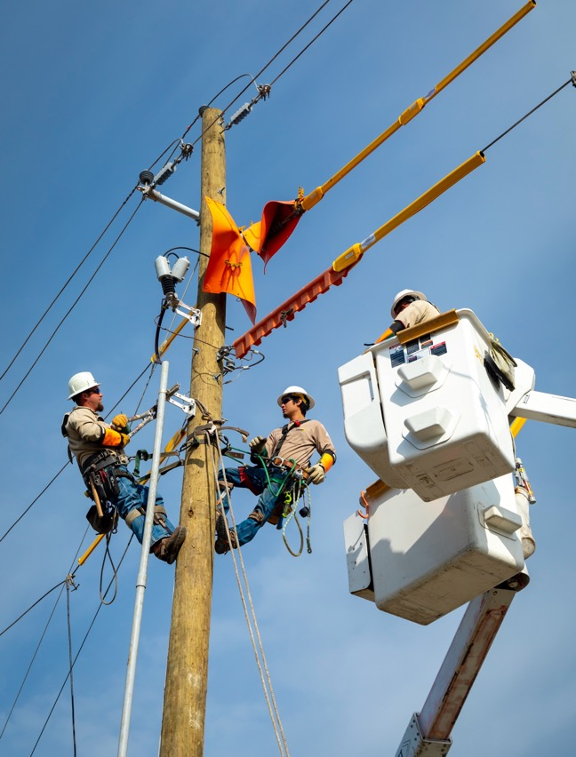
Tech Service and System Reliability
Distribution Engineering
System Engineering
Transmission Engineering/PM/Construction
Transmission Planning
Substation Eng/PM/Construction/Field Operation
System Protection Eng/PM/Const/Field Operation
Metering Eng/PM/Field Operations
System Operations
Real Time Operations – T&D
Field Telecommunications Eng/PM/Const/Field Operations

Slide 3
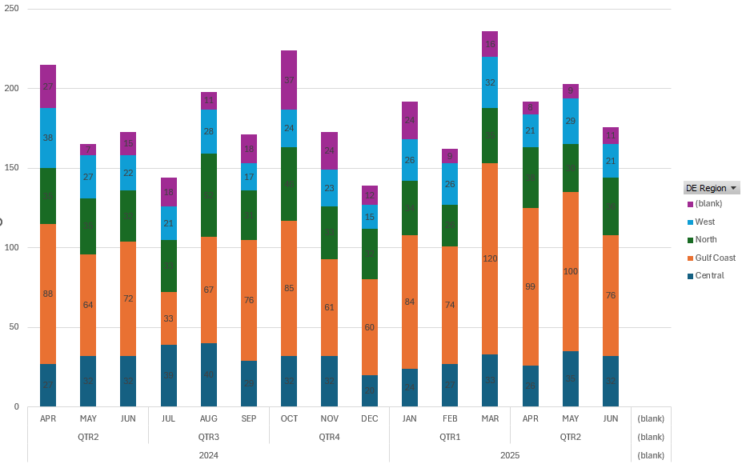
Tech Service and System Reliability
Distribution Engineering
New Service Portal
Power Clerk
DGR
26 In-service (21)
8 in Construction
7 in Study
GIS
Utility Network and DDS (Distribution Design Studio)
Modern GIS architecture with streamlined data structure
Easier database for improved data export processing and dashboarding
Improved connectivity for easier export and use in system studies

Slide 4
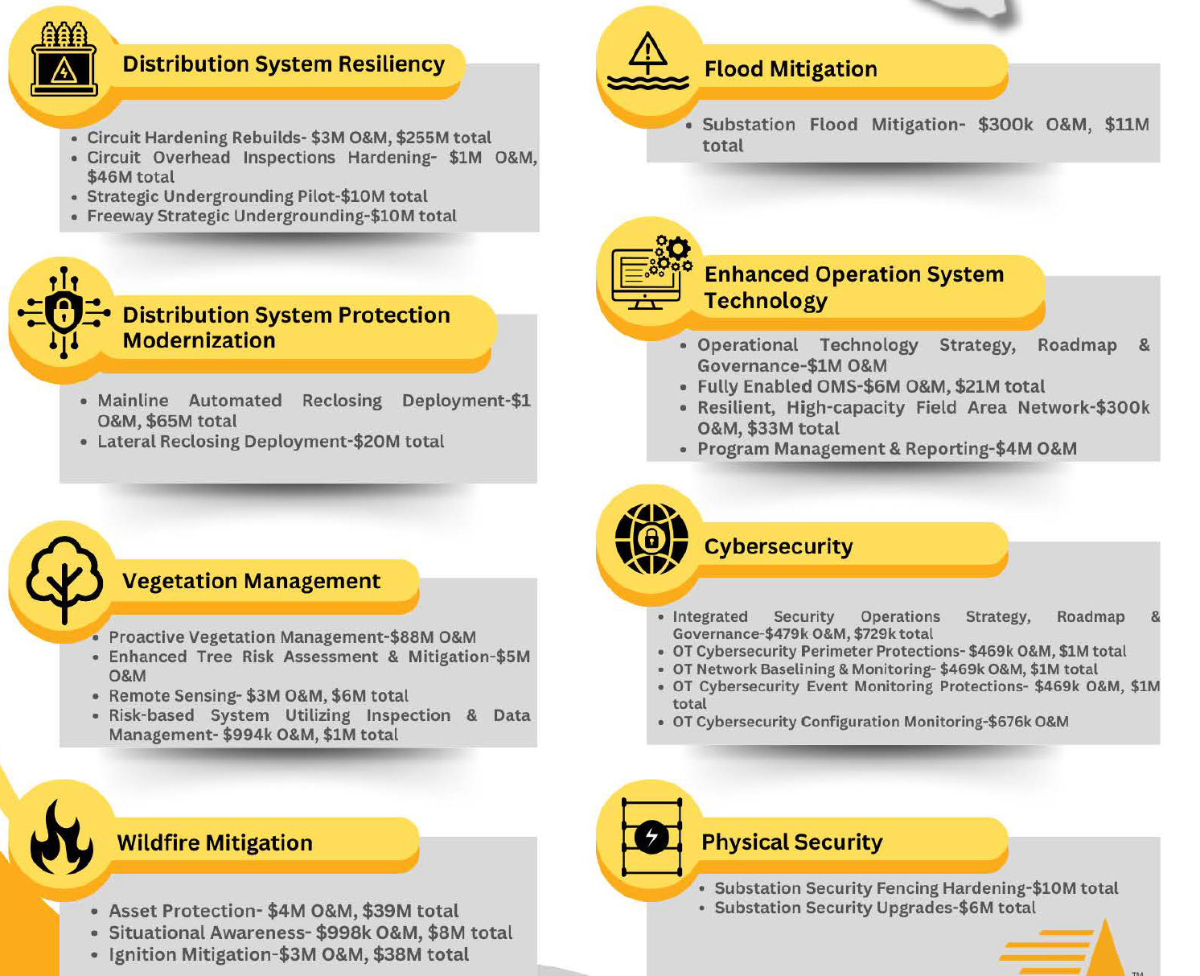
Resiliency Plan
Notes:
System Hardening
Hardened – In progress
Flood Prevention
System Modernization
Substation Relays
Field Area Network - Scada connected reclosers
Trip Savers
VM
Wildfire
Asset Protection/Situational Awareness/Ignition Prevention
Cyber Security/Physical Security

Slide 5
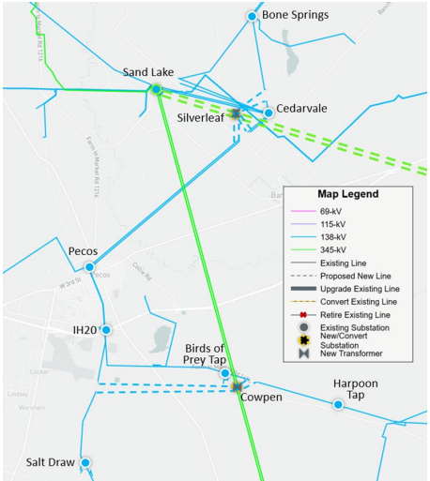
Tech Service and System Reliability
System Engineering – Silverleaf/Cowpen Project

Slide 6
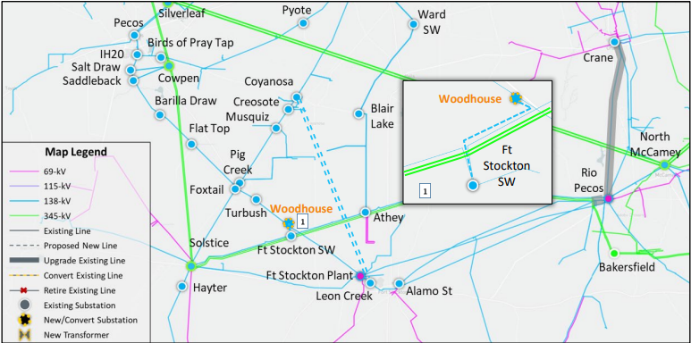
Tech Service and System Reliability
System Engineering – Pecos County Project

Slide 7
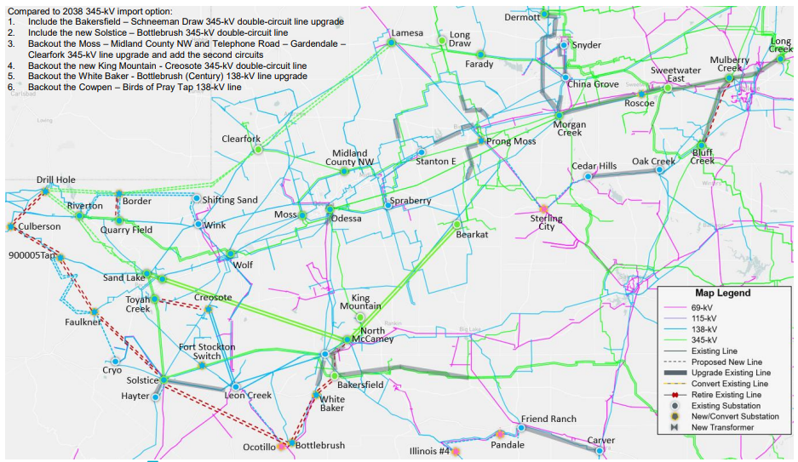
Tech Service and System Reliability
System Engineering – Permian Basin Project

Slide 8
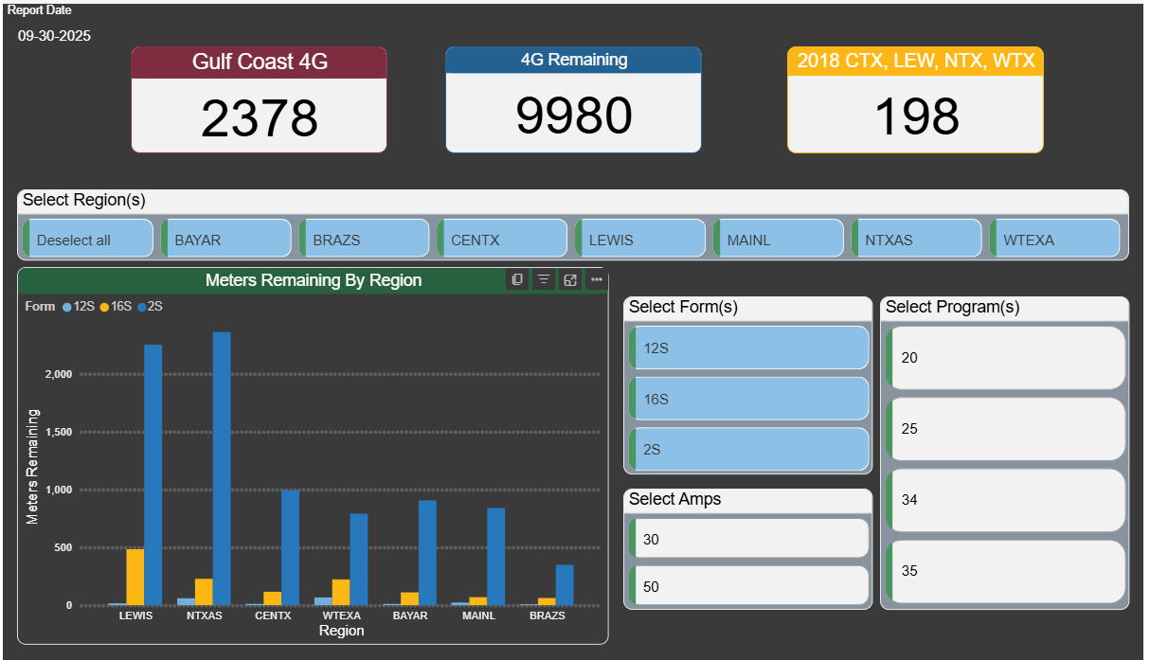
Tech Service and System Reliability
AMI Updates – RIVA Gen 5 – RF Mesh Network
Notes:
Installations by Year
2022 ~195K
2023 ~30K
2024 ~10K
2025 ~10K
2026 ~15K
2027 ~15K
Mesh Network Design
Full system design complete
Allows for replacement of any meter with a mesh meter
RIVA Cell based meter pending

Slide 9
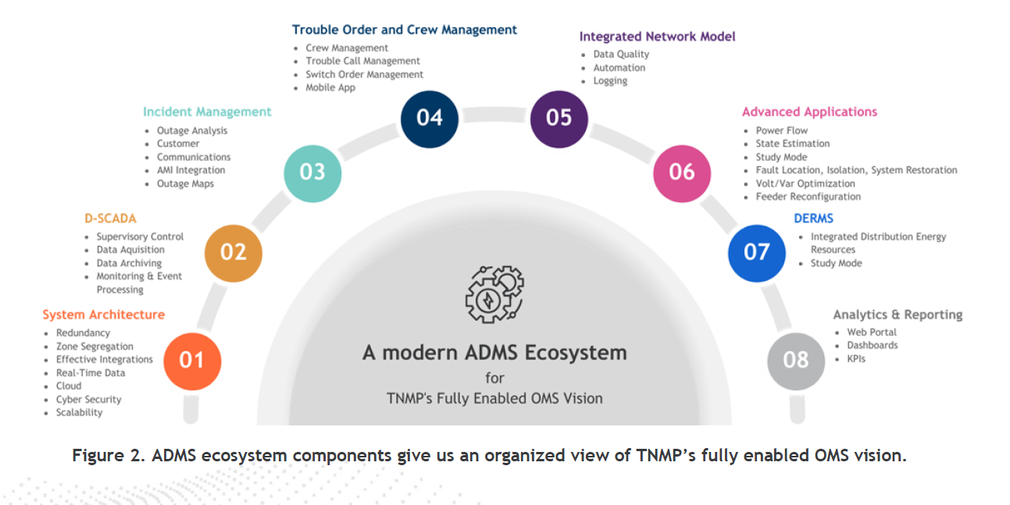
System Operation
Fully Enabled OMS
Notes:
Changes in motion,
implementation of a more integrated field worker
Advanced mapping updates
Scada deployment
AMS fleet replacement
Changes coming
Dedicated Scada system
OMS/ADMS Vendor

Slide 10
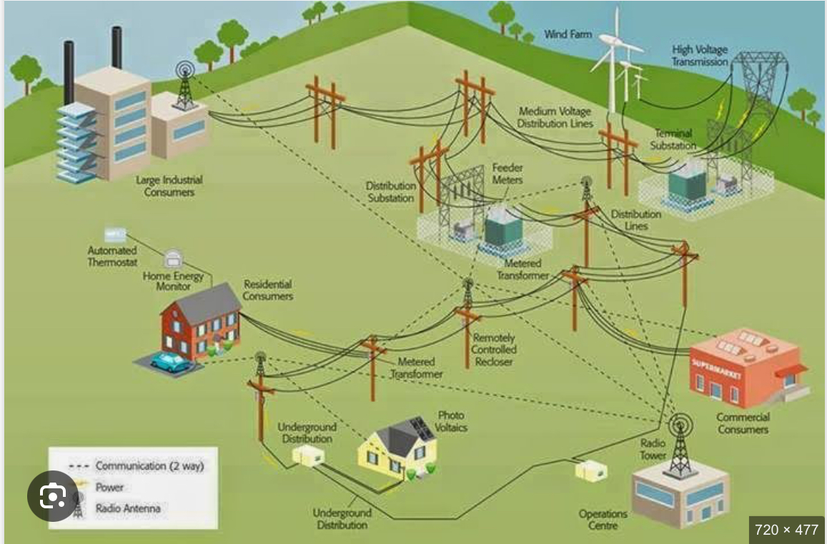
System Operation
Field Area Network

Slide 11
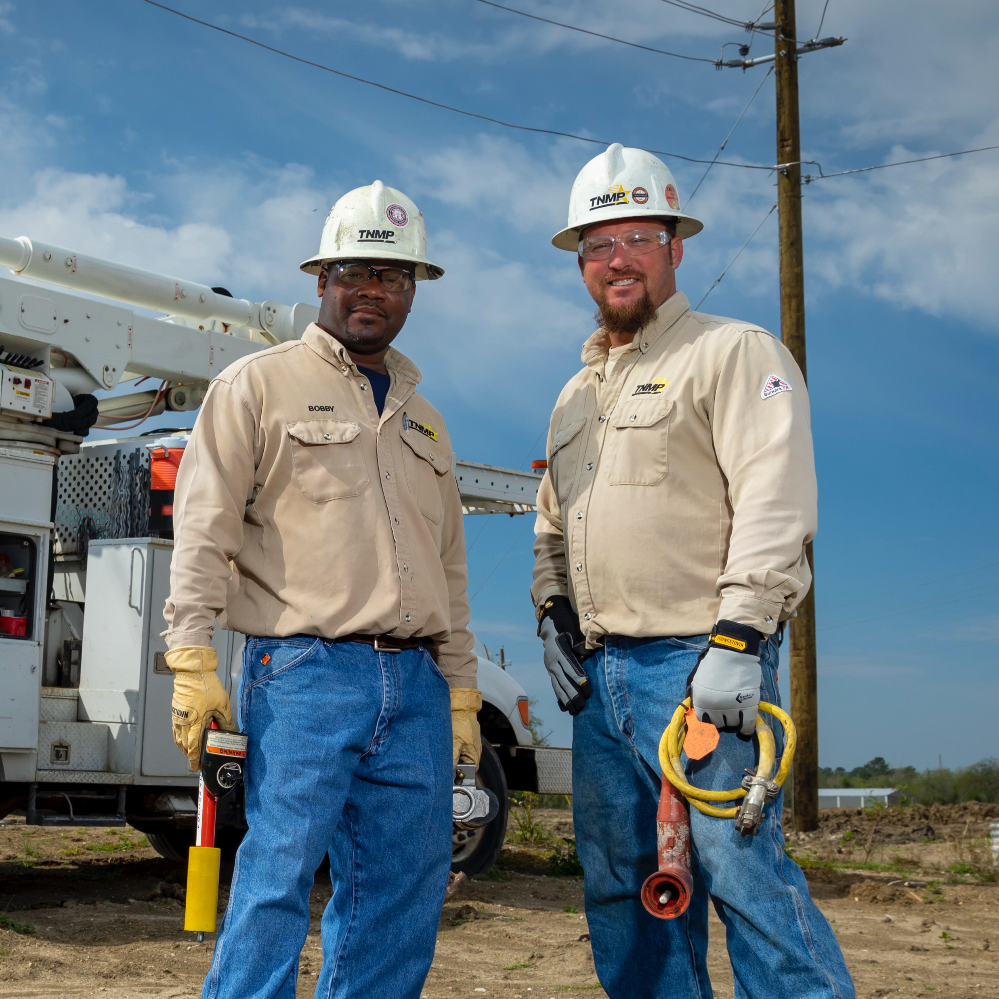
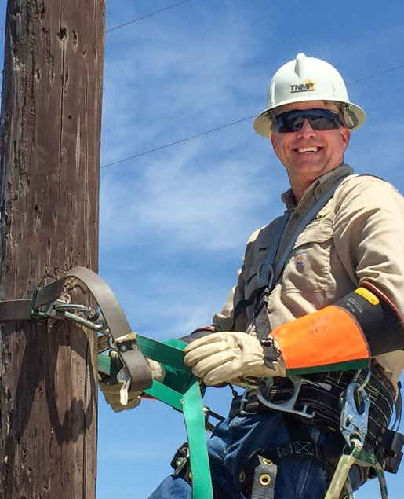


Questions?

