Slide 1


Customer Service Request for Engineering Support
TNMP PowerClerk Portal
Arturo Madrid
Distribution Engineering - DBA

Slide 2

TNMP PowerClerk Portal
          Backup Generation
          Encroachment Review
            Pool Plan Review
            Encroachment Review
            Plat Review
            Will Serve Letter Request
            Fault Study
          Interconnection Application – Solar / Battery
            New Service Delivery
              Residential / Commercial
              Petroleum
            Transmission Interconnection – Coming soon
              Load
              Generation
              Crossing Permit

Slide 3
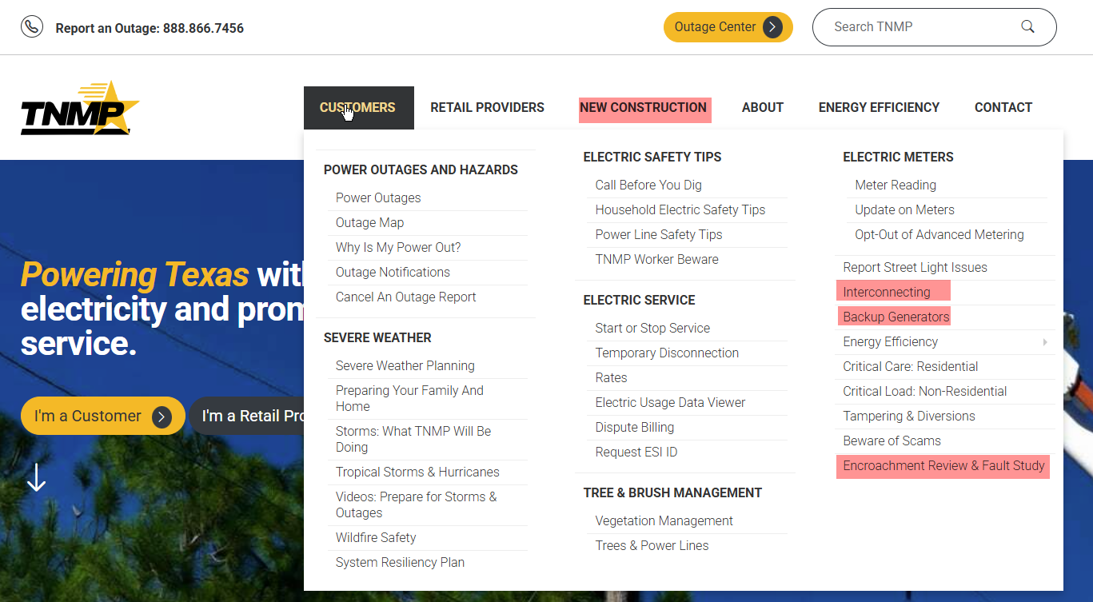
Where to find PowerClerk Portal
All the request portals are link off the TNMP.com website
Each link takes to you a page with category specific details

Slide 4
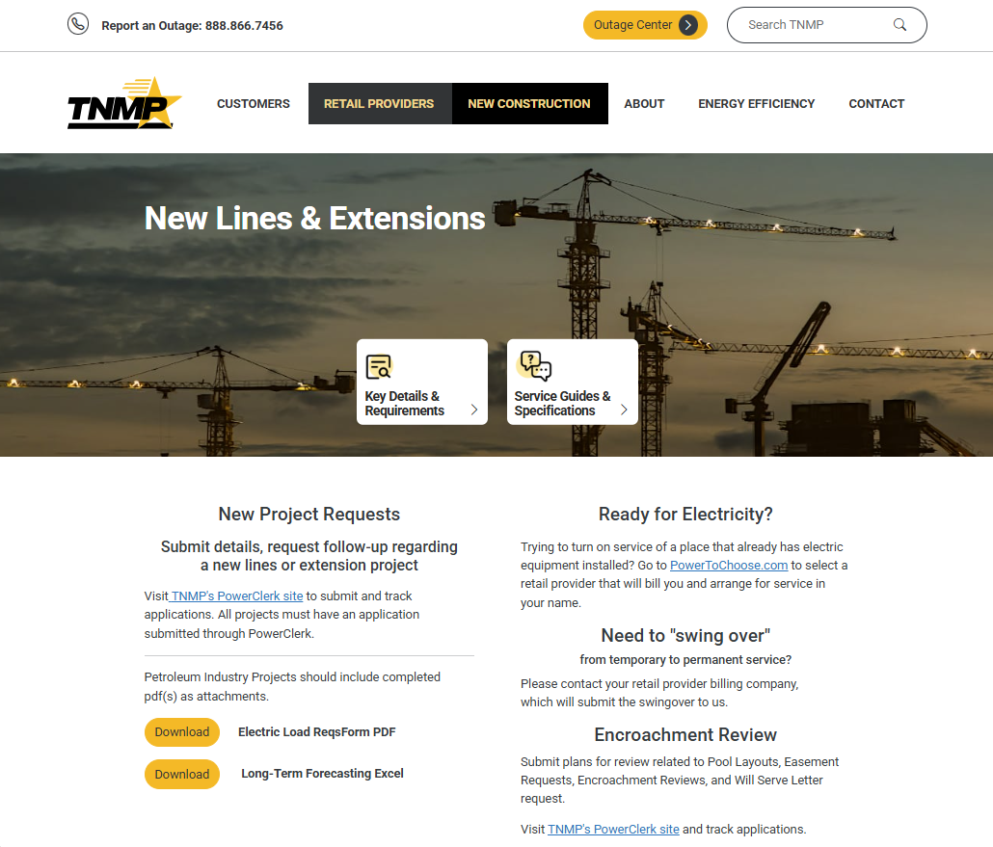
New Construction Tab

Slide 5
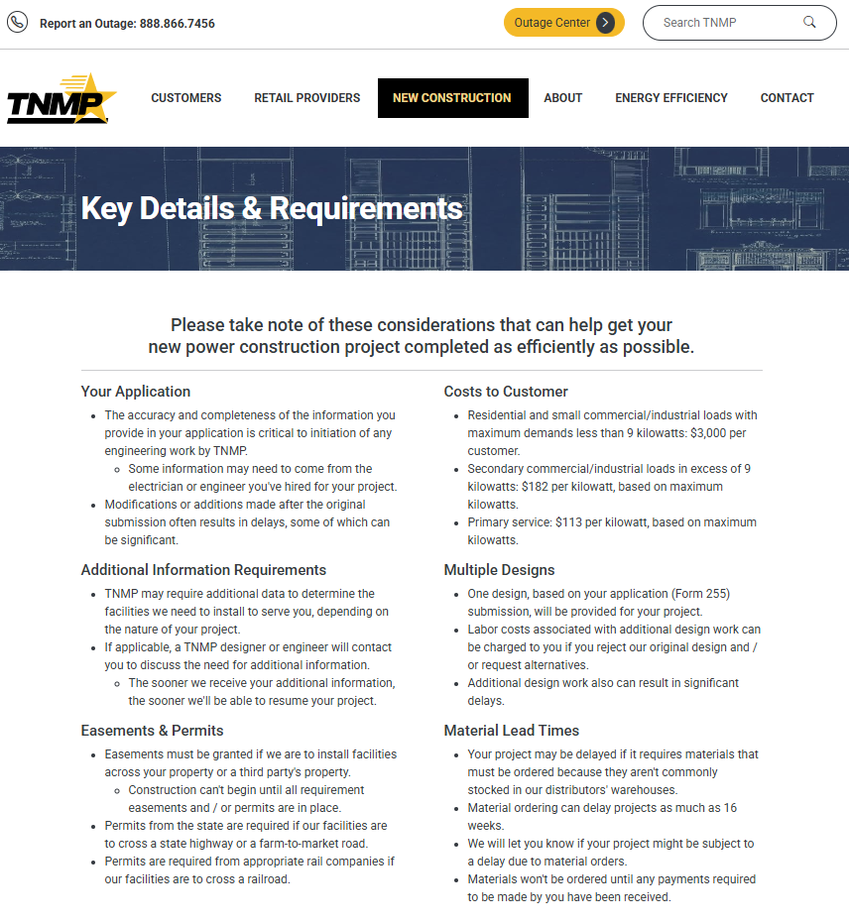
New Construction Tab cont.

Slide 6
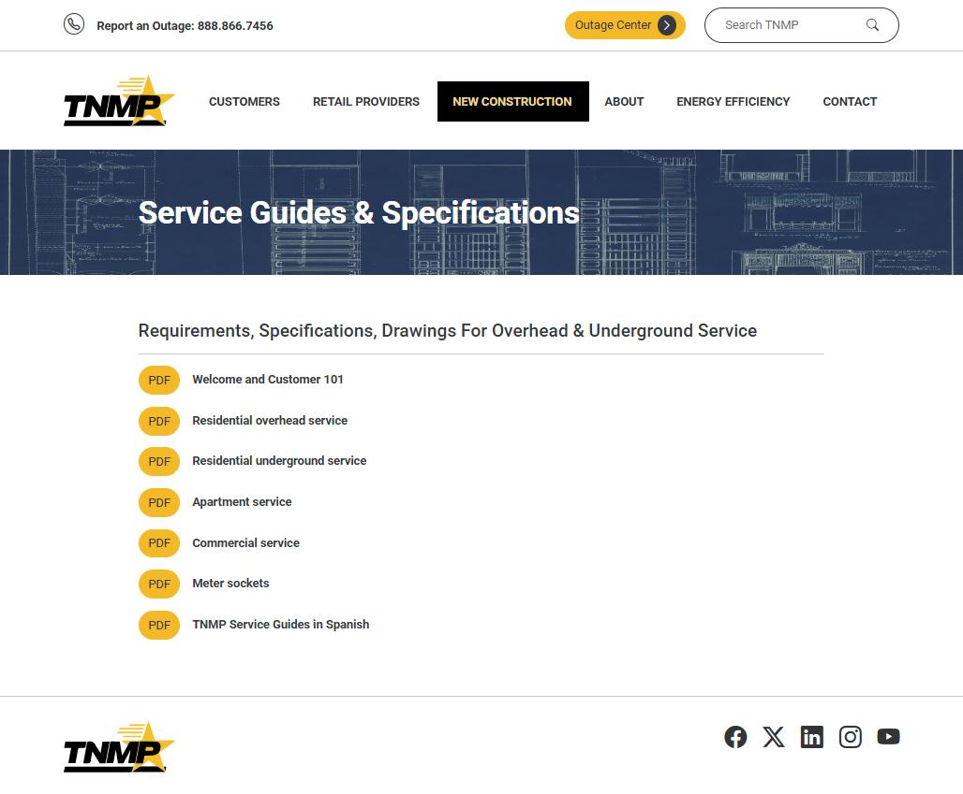
Service Guides
& Specifications
New guides with key details on service requirement for new construction projects.

Slide 7
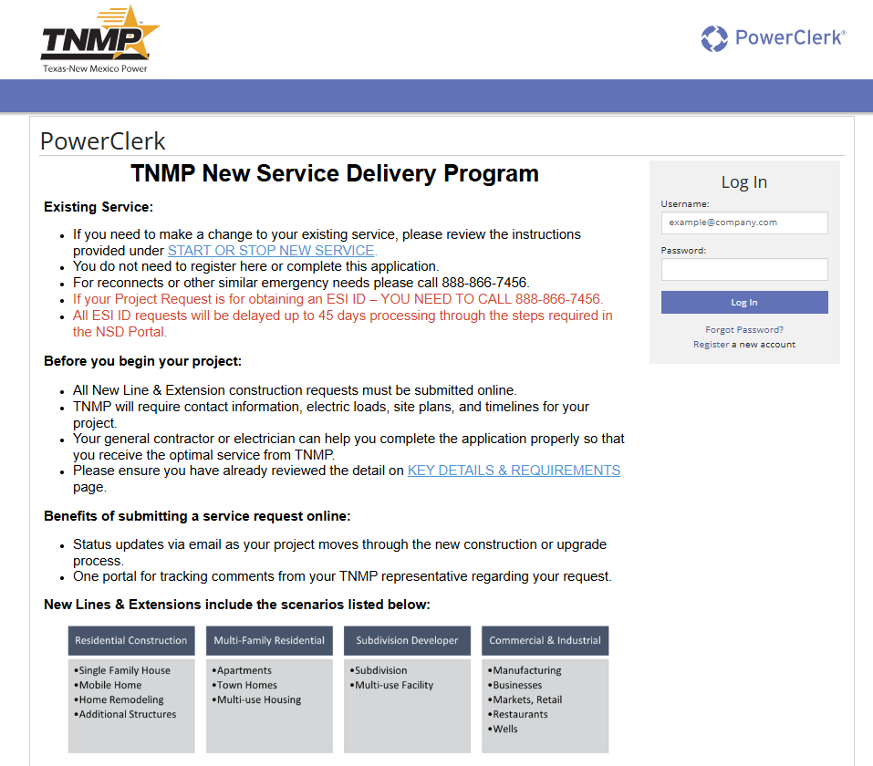
Why PowerClerk?
Each portal allows the customer to self register for the program in question.
Automated communication on standard steps
Easy project reference within the portal
Automated point of escalation for customer
Backend reporting and project tracking

Slide 8
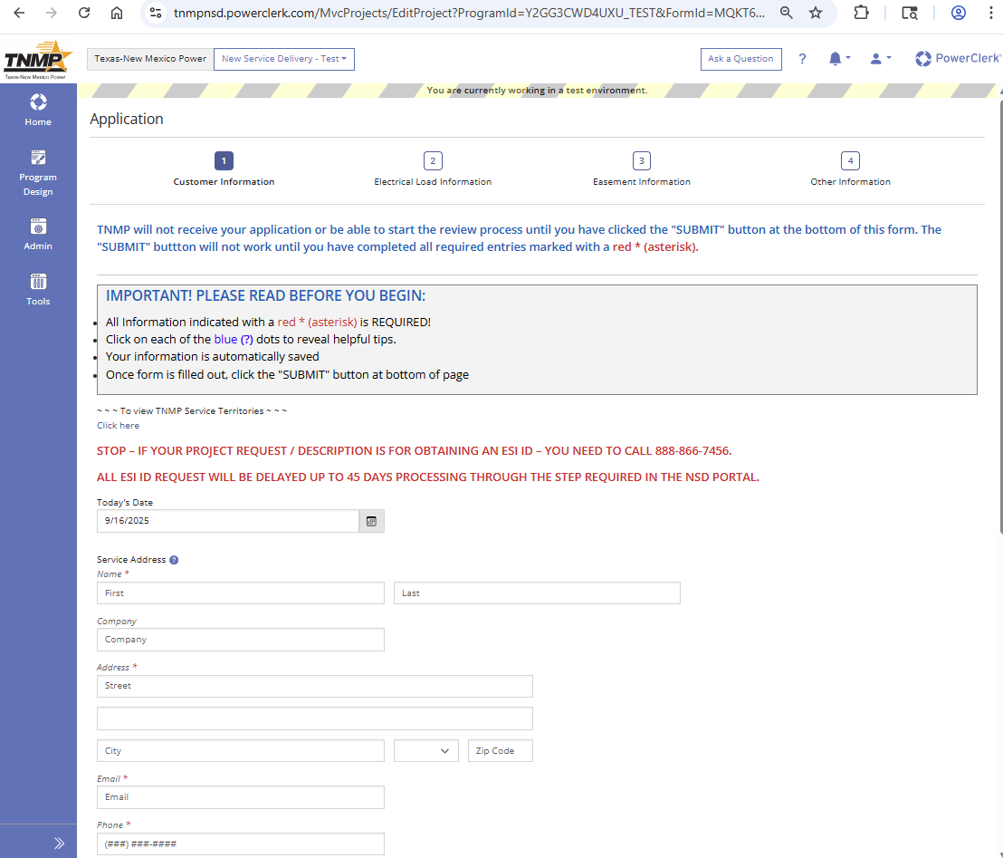
What do I need on an NSD Application?
Required Details
Customer Name
Service Address
Email
Phone #
Project description
Electric load details
Optional depending on project specifics
Easement information
Builder / contractor contacts
Electrical contractor contact
There is an “I Don’t Know” response to keep application moving forward in the submit process.

Slide 9
Project Timelines
          Backup Generation – up to 15 business days
          Encroachment Review – 4 to 6 weeks per application
            Pool Plan Review
            Encroachment Review
            Plat Review
            Will Serve Letter Request
            Fault Study
          Interconnection Application –
            averaging 8 to 10 business days to complete interconnection agreement
            Action from notice of installation averaging 18 days
            New Service Delivery – up to 3 weeks for initial review and contact
              Residential / Commercial
              Petroleum
            Transmission Interconnection – Coming soon
              Load
              Generation
              Crossing Permit

Slide 10

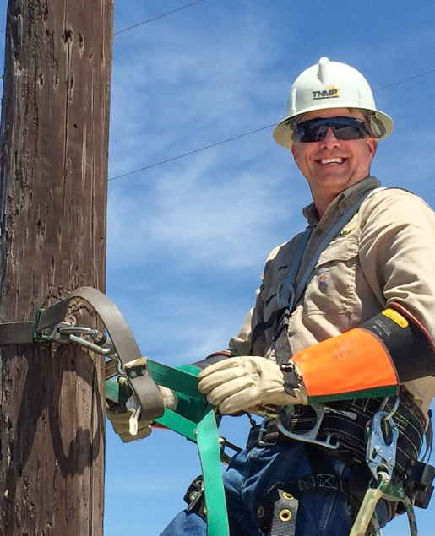


Questions?

