Slide 1


Energy Efficiency
Josh Campbell
Program Manager
josh.campbell@tnmp.com
512-694-0559

Slide 2
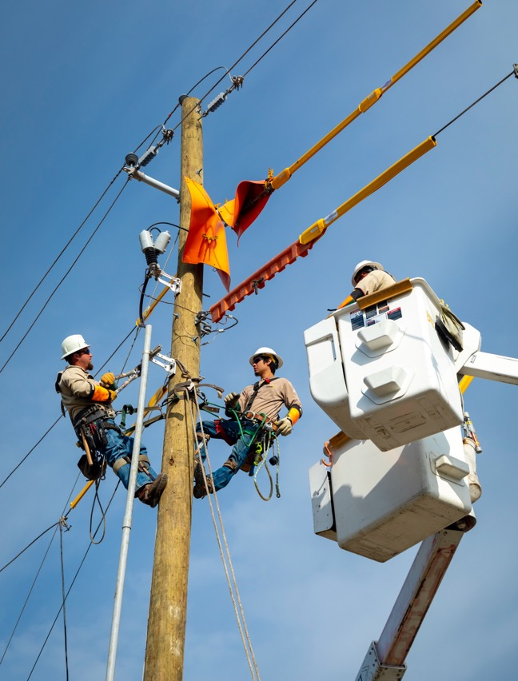
Objectives
Why does TNMP offer EE programs?
What programs do we offer?
2024 programs in action
Looking ahead to 2026

Slide 3
History
Authorized by 76th Texas Legislature in 1999 as a result of deregulation.
Governed by PURA § 39.905 and 16 Texas Admin Code (16 TAC) § 25.181.
All Texas investor-owned utilities must meet annual demand and energy savings goals.
Residential and Commercial portfolio of programs designed to target every customer segment.

Slide 4
Regulation & Funding
Annual regulatory dealings:
EEPR (Energy Efficiency Plan and Report)
Filed by April 1st
Reports on previous year, current year, and projected year
EECRF (Energy Efficiency Cost Recovery Factor)
Filed by June 1st
A rate rider collected to fund the programs
EEIP (Energy Efficiency Implementation Project)
Bi-annual public meetings at the PUCT where stakeholders are invited to participate
Annual 3rd party Evaluation, Measurement and Verification contracted by the PUC to review methodologies and ensure savings.

Slide 5

What programs do we offer?

Slide 6


Commercial Programs
COMPASS for Small Business
Small commercial customers (≤ 200 kW)
COMPASS for Large Commercial
- Large commercial customers (>200 kW).
COMPASS for Schools/Government
- School districts and local government
Commercial Load Management
Winter (December 1st to February 28th)
Summer (June 1st to September 30th)

Slide 7
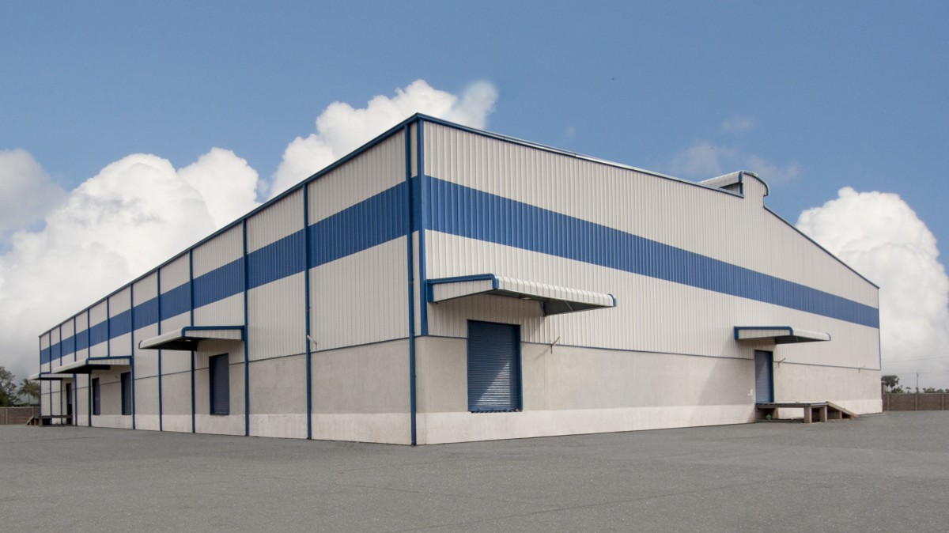

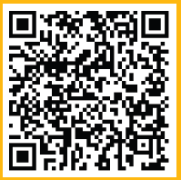
C MPASS
Building assessments
Recommendations and planning
Energy and cost savings estimates
Communication support
Cash incentives

Slide 8
C MPASS
Lighting
HVAC
Building envelope
Refrigeration
Variable frequency drives
Food service and kitchen equipment
Custom projects

Slide 9
Residential Programs
High-Performance Homes
- Incentivizes new construction home builders to build above code.
- Rewards ENERGY STAR® certified homes.
Residential and Hard-to-Reach Standard Offer Program
- Incentives paid to Project Sponsors (contractors) who install various measures.
- Common measure include ceiling insulation, LED bulbs, advanced power strips, and more.
Low Income Weatherization
- Targets low-income customers.
- TNMP must spend 10% of the budget here.
- Measures are performed through participating agencies.

Slide 10
2025 Program Portfolio
Customer Class and Program | Demand Goal (kW) | Energy Goal (kWh) | Incentive Budget
Commercial | 3,002 | 9,728,434 | $2,100,000
COMPASS for Small Business Program | 925 | 2,247,602 | $700,000
COMPASS for Schools/Government | 1,000 | 3,240,651 | $700,000
COMPASS for Large Commercial Program | 1,077 | 4,240,181 | $700,000
Load Management SOP | 10,625 | 10,625 | $425,000
Winter Load Management | 1,875 | 1,875 | $75,000
Summer Load Management | 8,750 | 8,750 | $350,000
Residential | 6,461 | 5,180,044 | $1,750,000
High-Performance Homes | 933 | 1,785,159 | $550,000
Residential Standard Offer Program | 1,500 | 3,382,800 | $1,200,000
Residential Load Management Program | 4,028 | 12,085 | $200,000
Hard-to-Reach | 1,356 | 2,223,916 | $1,150,000
Hard-to-Reach SOP | 760 | 1,029,900 | $500,000
Low Income Weatherization | 596 | 1,194,016 | $600,000
Totals | 21,444 | 17,143,019 | $5,625,000

Slide 11
2024 Program Highlights

Slide 12


2024 Residential Program Summary
 | Residential SOP | Hard-to-Reach SOP | High Performance New Homes | Low Income SOP | Total
Total Spend | $1,526,738 | $526,153 | $538,984 | $744,484 | $3,336,359
# Customers | 2,246 | 577 | 796 | 250 | 3,869
# Installed Measures | 4,212 | 983 | 1,096 | 741 | 6,268
kW Savings | 1,934 | 714 | 973 | 588 | 4,209
kWh Savings | 4,529,999 | 966,588 | 2,532,559 | 1,162,469 | 9,191,615
735 homes’ energy for one year
499,260,577 smartphone charges

Slide 13
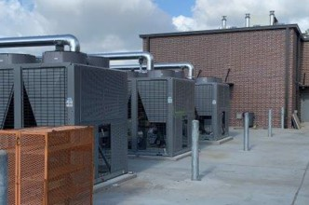

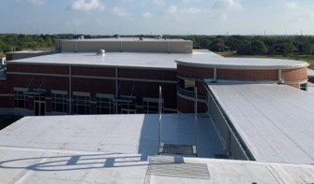
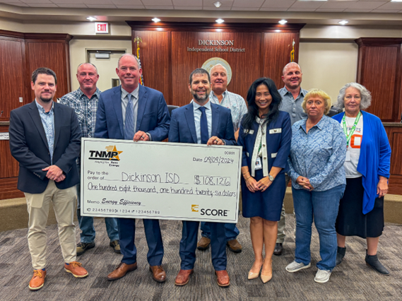
Project Highlights
Multiple Chiller and HVAC Retrofits
Estimated Annual Energy Savings
182 kW
Estimated Cost Savings and Incentives
941,092 kWh
Roof Replacement
Summer Load Management
Cash Incentives: $108,126
Annual Cost Savings: $100,696
LED Lighting Retrofit

Slide 14

New for PY 2026
Small Business Direct Install
Small to medium size businesses
Pre-qualified contractor network
LED tubes with ballast bypass, air infiltration, faucet aerators, smart thermostats
All material and labor paid by TNMP

Slide 15
New for PY 2026
REP Smart Thermostat Program Pilot
Addresses certain goals expressed in SB 1699
Cash incentives paid to REPs for the installation of smart thermostats for residential customers
Customer recruitment or retention
Reps can enroll these devices in DR programs
Simple documentation requirements
Incentives paid monthly

Slide 16

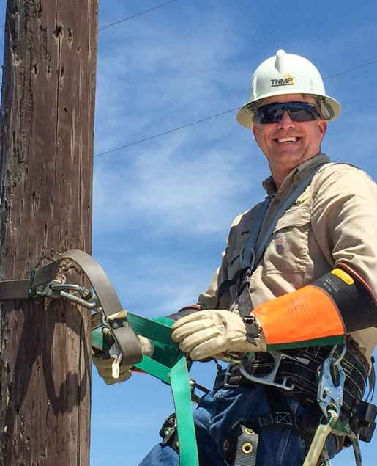


Questions?
Josh Campbell
Program Manager
josh.campbell@tnmp.com
512-694-0559

