Slide 1
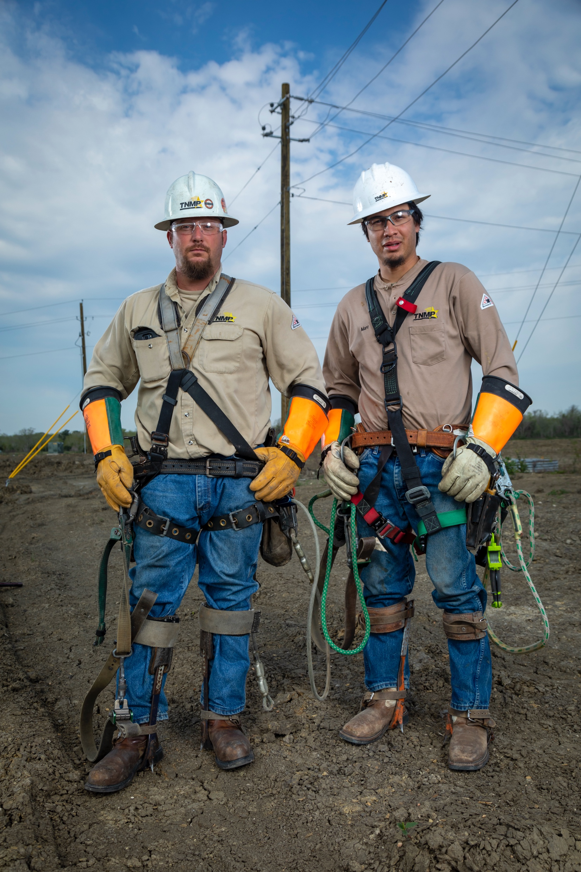

Emergency Preparedness & Response
What’s happened since Hurricane Beryl
Keith Nix, P.E.
Vice President - Operations

Slide 2
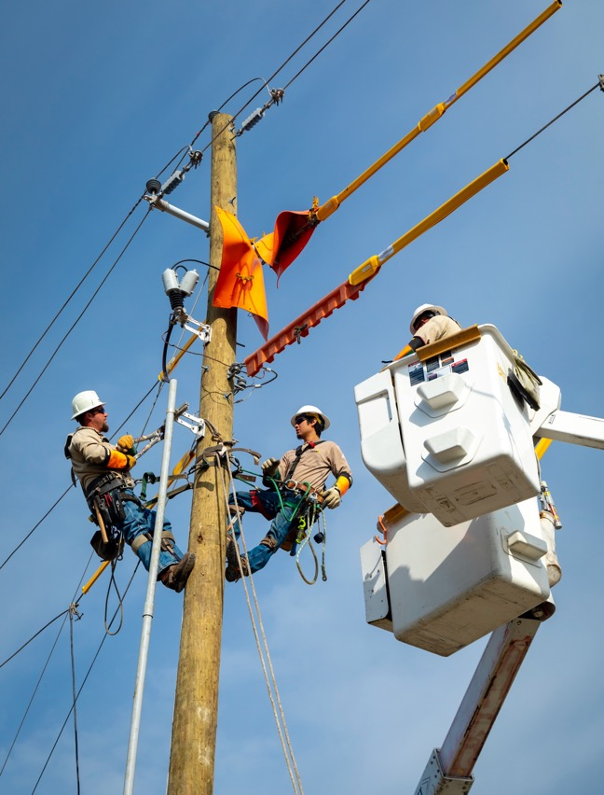
Everyone wants to know....
Do I have Beryl PTSD?? YES!!!!
What have we done since to help me?
What can I share to help you?
What reviews/changes have been made for TNMP’s Emergency Preparedness & Response that is relevant to you and our customers?

Slide 3
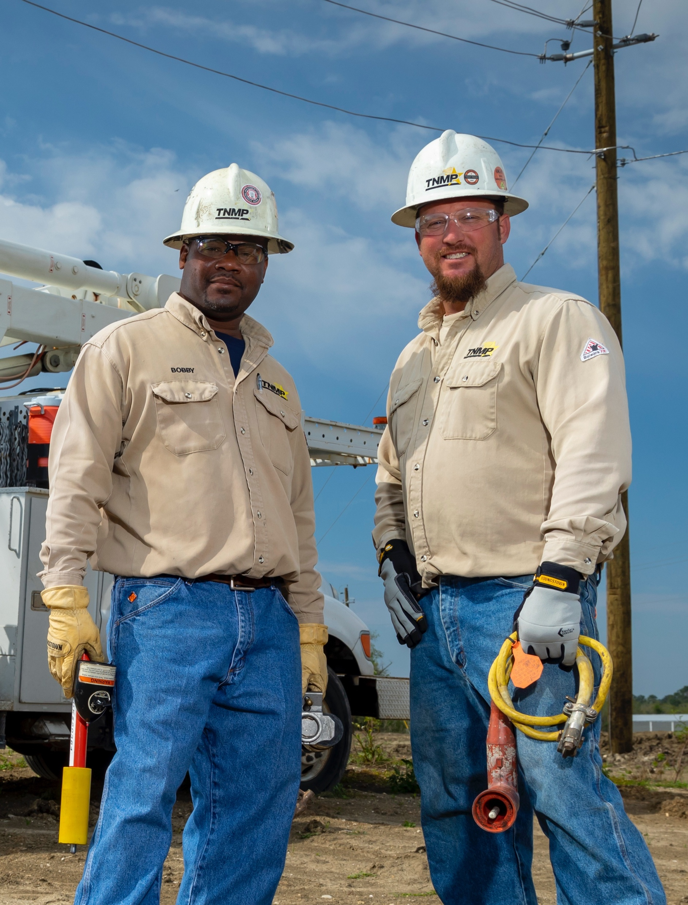

What did we do since?
After Action Assessment Report completed 11/2024
Done by outside firm with utility experience driven by formal interviews with TNMP personnel, review of actual event data and response times for additional personnel
Resulted in recommendations ranging from updated Emergency Operations Plans, structural/functional changes and roles/responsibilities changes for employees
Resource evaluations (internal and external) performed for the event
Communications strategy changes

Slide 4
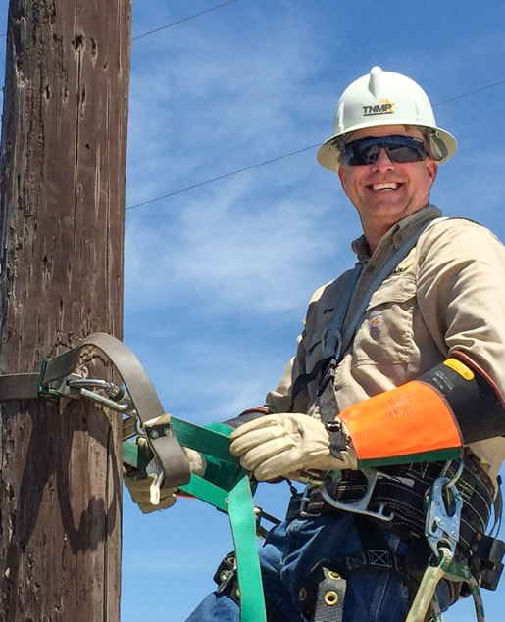

What did we do since?
Emergency Operations Plan Changes
Completely revamped EOP’s to conform with FEMA governance structure for clarity and communications/command and control
Plans were re-filed with the PUCT and incorporate required changes from PUCT and legislative actions
Plans are still regionally based to keep specific customers/areas in focus but retain the same baseline structure

Slide 5
What did we do since?
Resource Acquisition prior to or immediately following the storm or other events
Contracted with large nationwide contractor to provide “Quick Reaction Force” type support immediately prior to or following storm events
Can be tailored to TNMP needs and can be self-reliant or imbedded with TNMP crews
Helps with first response and can be pre-staged well ahead of known events so that we have the proper initial “boots on the ground” as quickly as possible
Working to leverage technology as much as possible

Slide 6
Big change....Vegetation Management
Have moved Vegetation Management into TNMP from a corporate function as part of System Resiliency Plan
Expanded the amount of FTE’s in department from 3 to 15 which includes Analysts, Specialists and experienced supervision
Will be transitioning to a “cycle based” approach to VM versus more of a “reactive” approach
Vegetation was the main cause during both Hurricane Beryl and North Texas wind events in 2024 timeframe as a reminder!!

Slide 7
Other Changes
Integrating systems to Outage Management System (OMS) for quicker response times
Continuous improvement in communications strategies and ways to reach out to TNMP (think social media/customer call centers)
Weather monitoring upgrades are coming with SRP in some areas
Better storm awareness and willingness to execute on upcoming events
SUMMARY – will my PTSD ever go away?? NOT LIKELY!!!

Slide 8
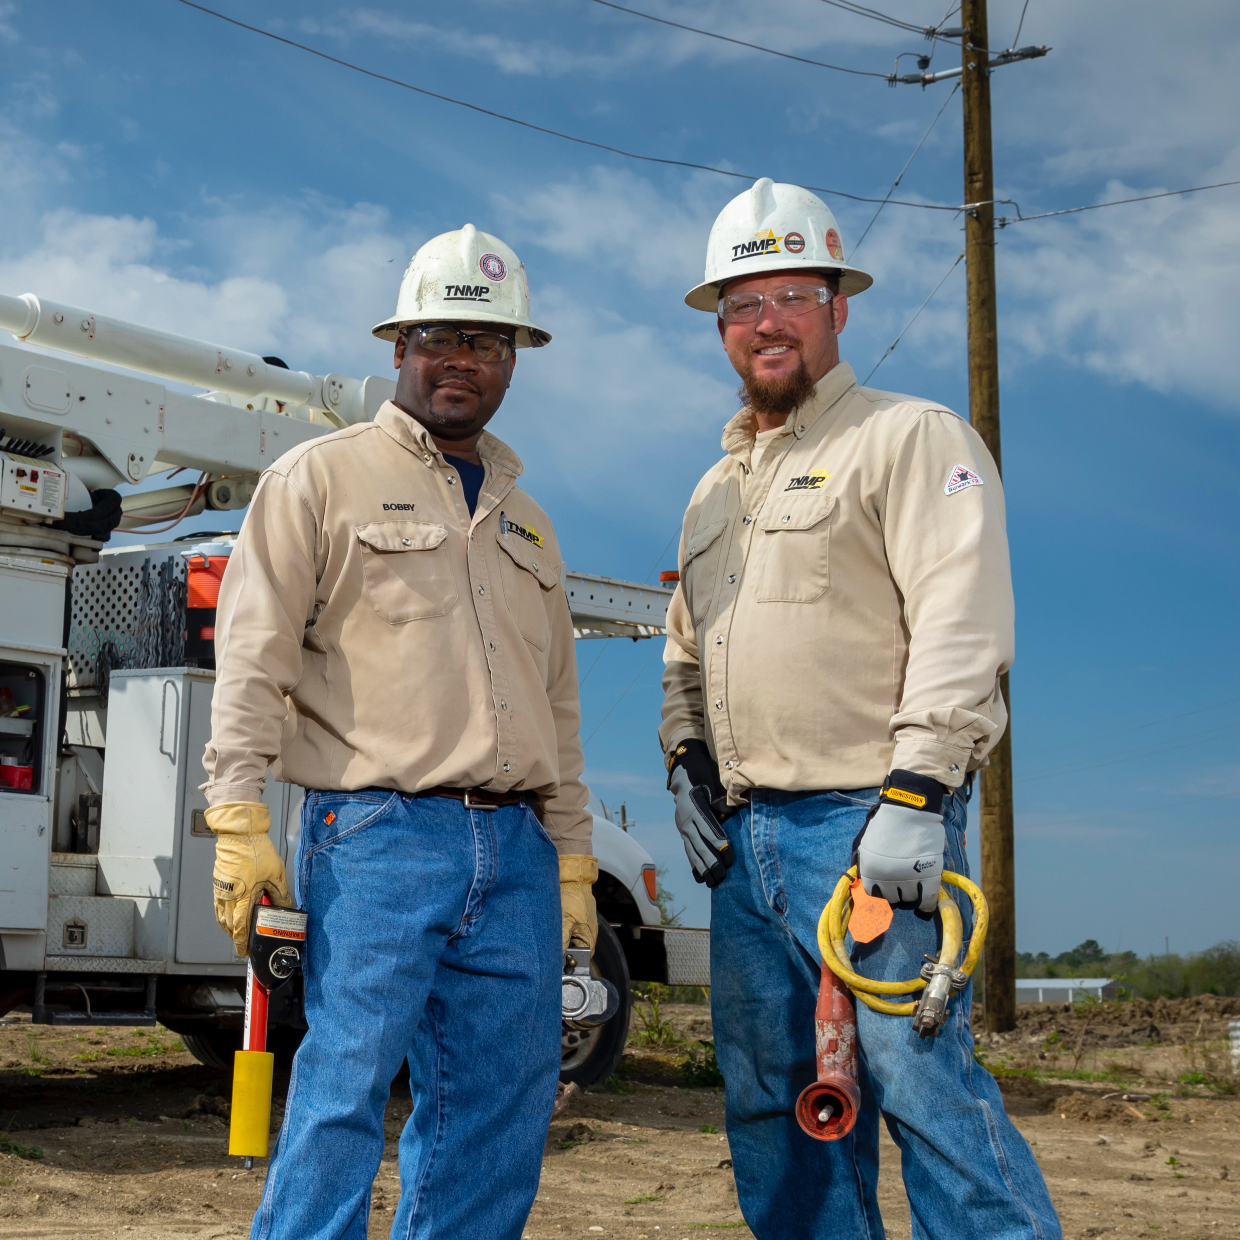
Questions?

