Slide 1
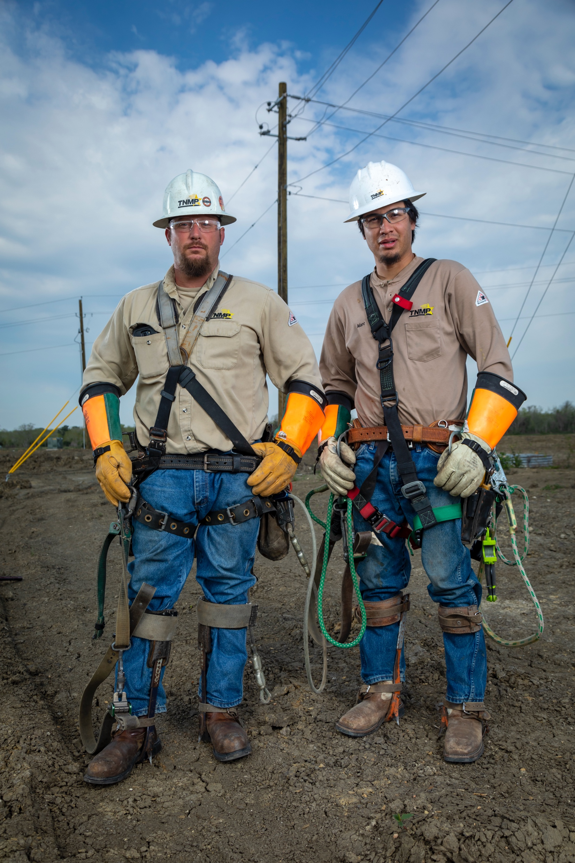

Website Update
& Outage Communication Strategy
The Changes Being Made to TNMP’s Website and Outage Communications
Sara Yingling
TNMP Communications Manager

Slide 2
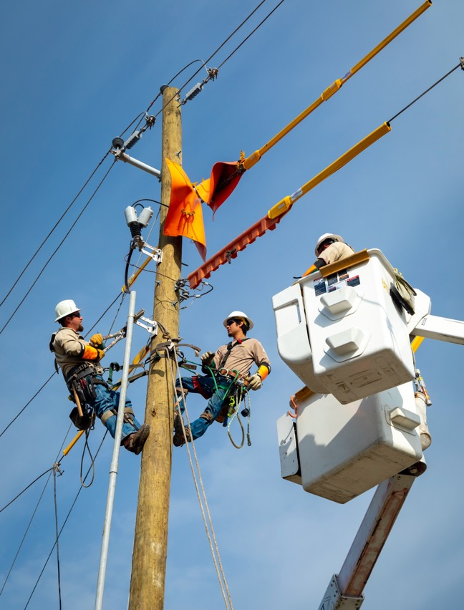
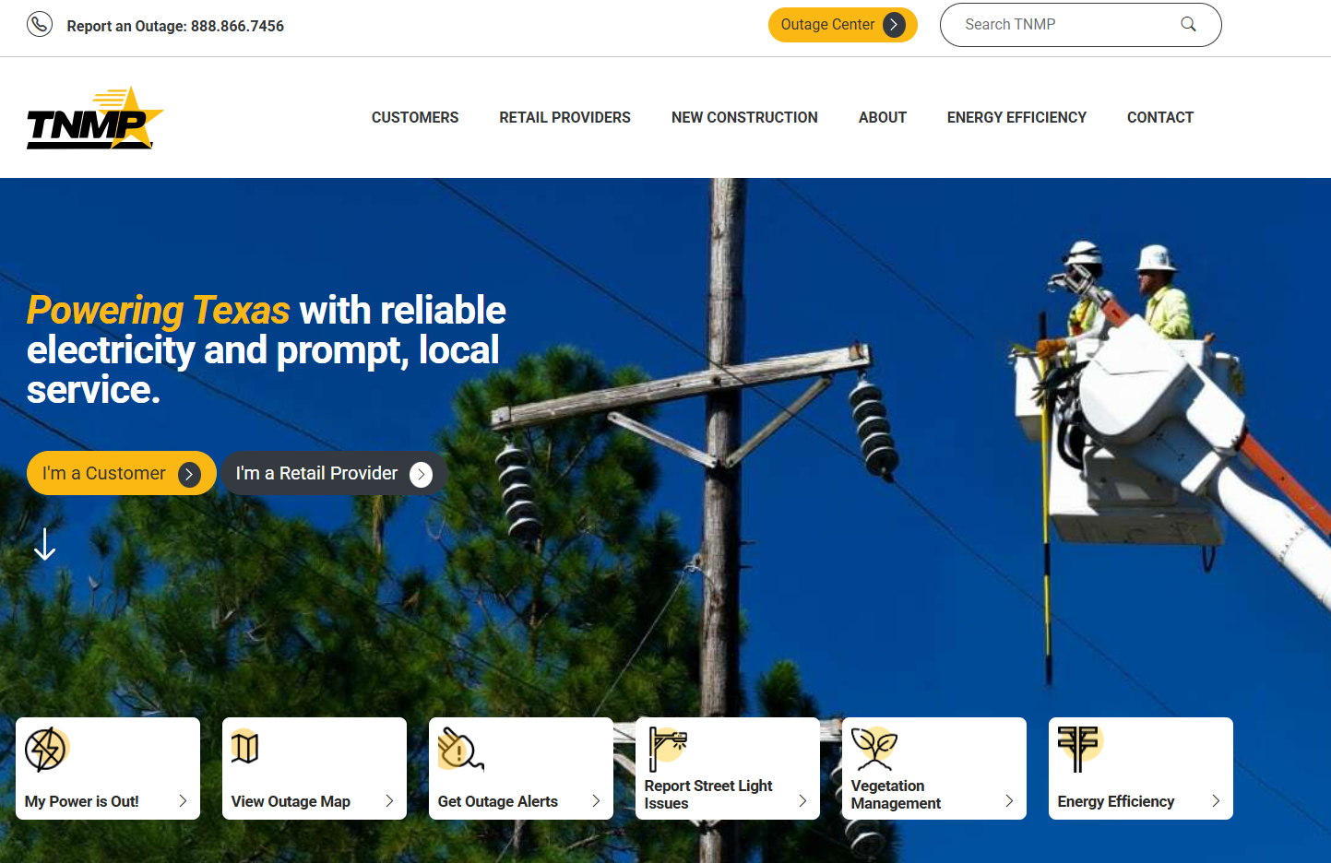
Website Redesign
Launched February 18, 2025

Slide 3
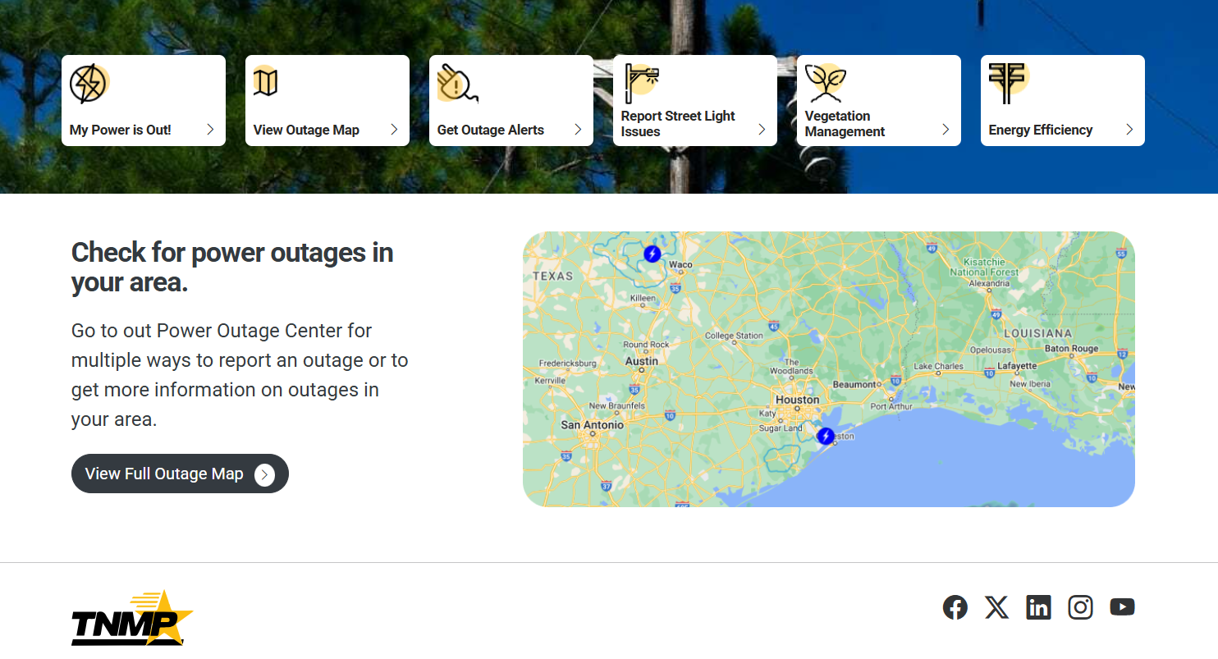
Website Redesign
Homepage

Slide 4
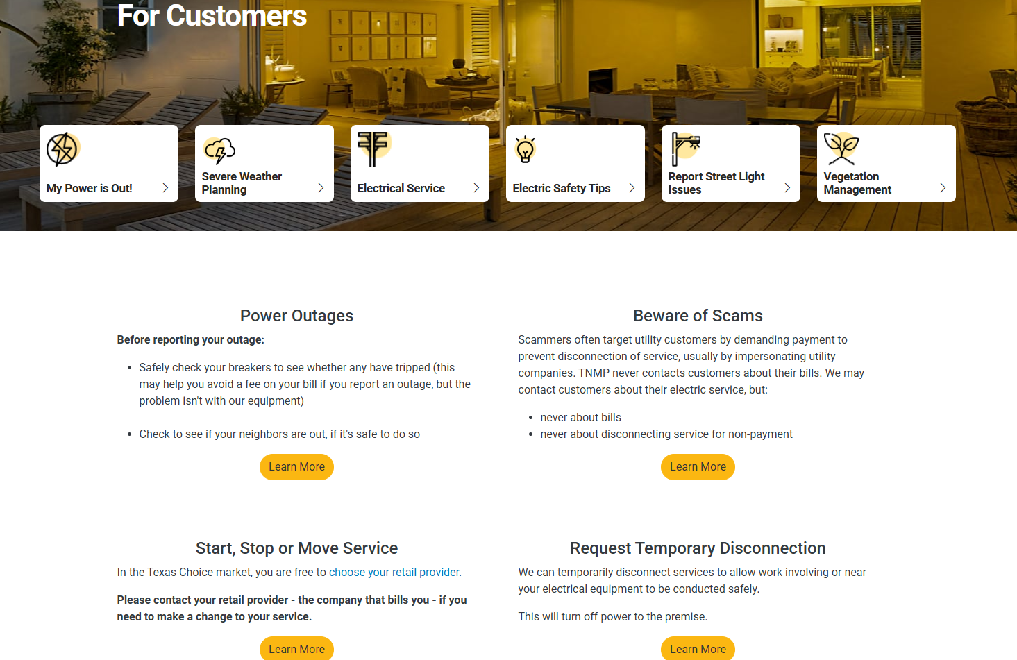
Website Redesign
For Customers

Slide 5
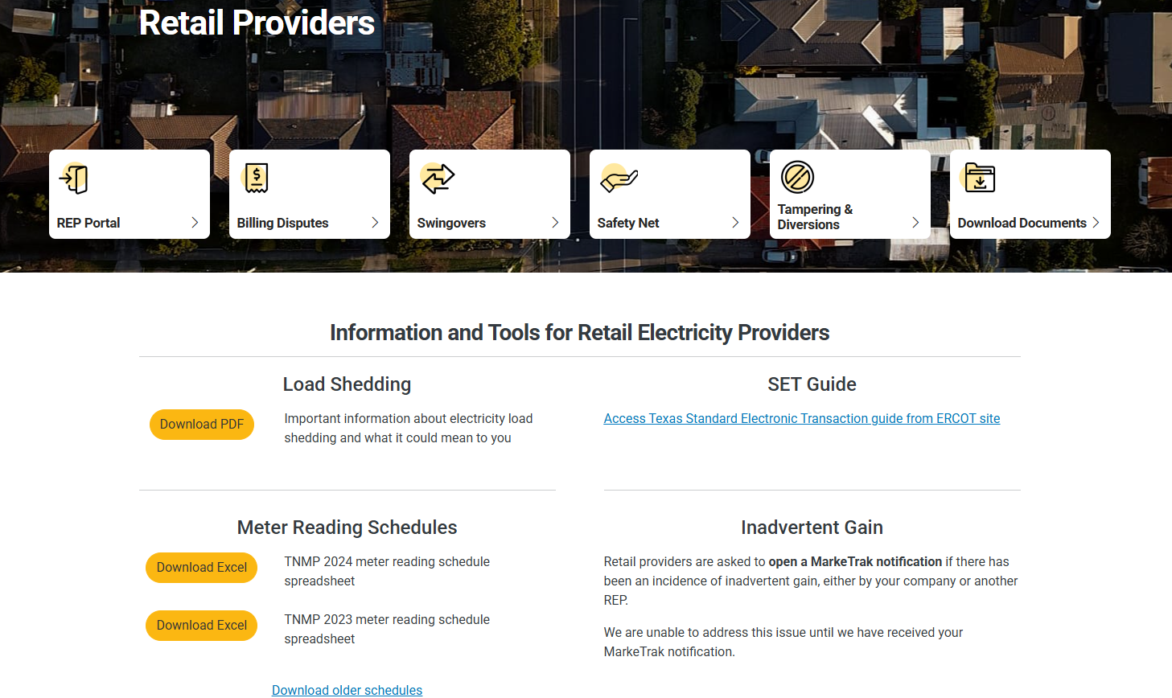
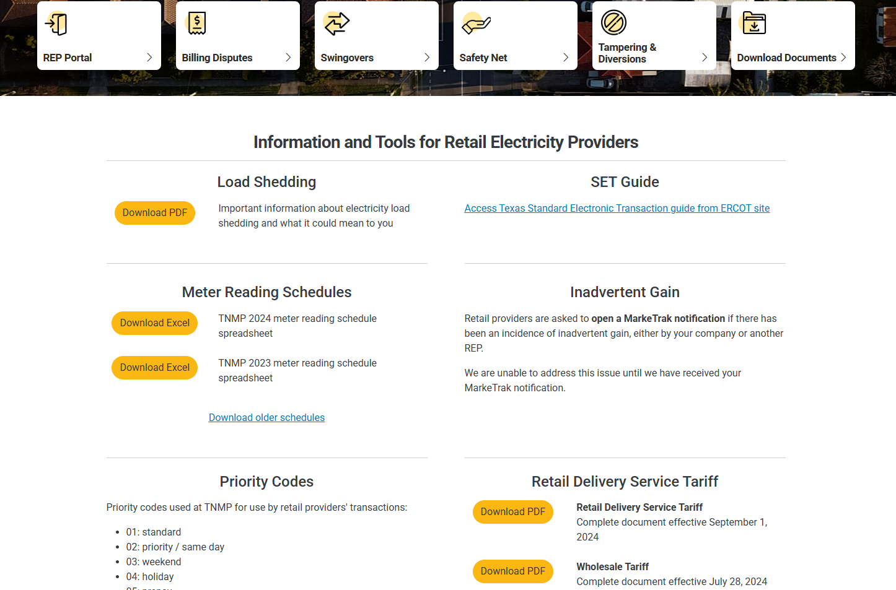
Website Redesign
REP Portal

Slide 6
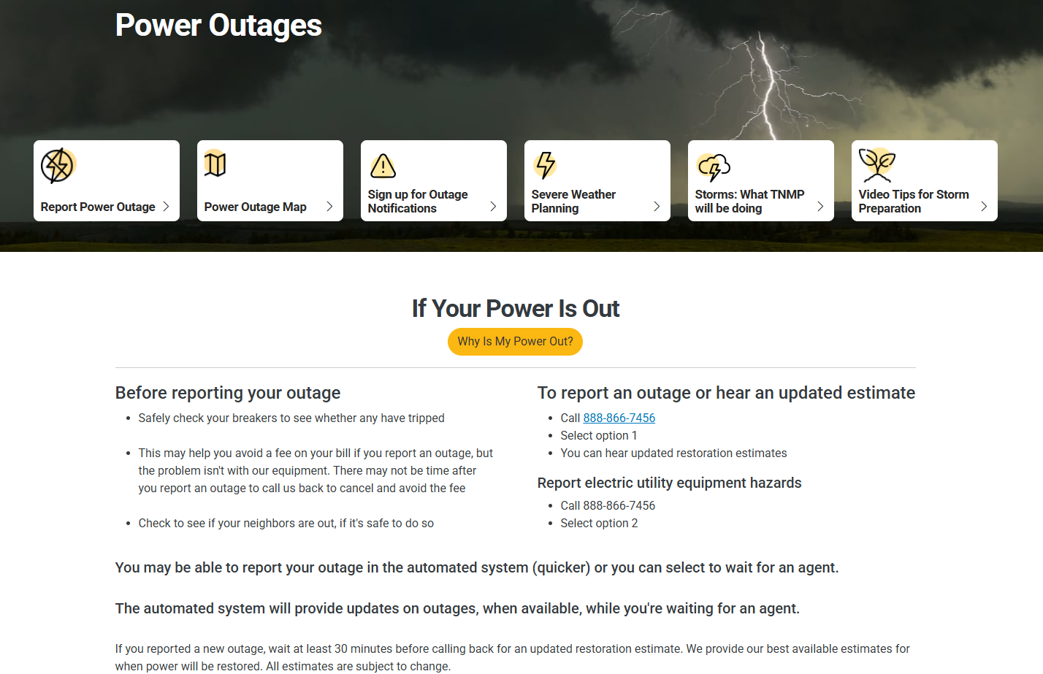
Website Redesign

Slide 7
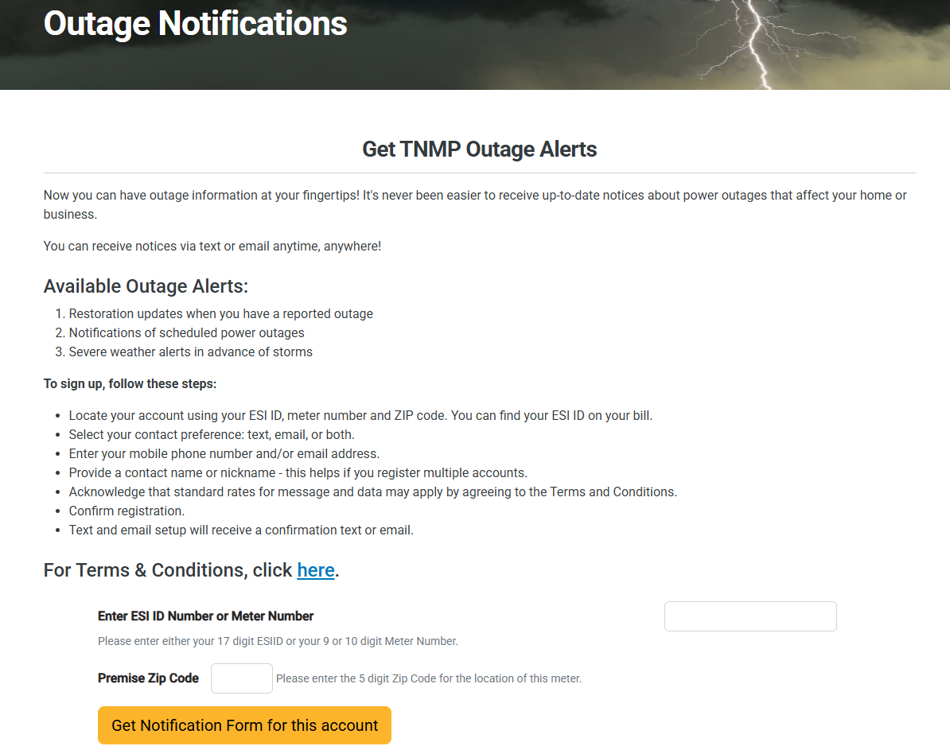
Outage Communications

Slide 8
Outage Communications
KUBRA Spanish Notifi
  Kick-off with KUBRA: 7/18/25
  Analysis & Design: 8/4/2025
  Development: 7/28/2025-9/29/2025
  Testing: 9/30/2025-10/28/25
  Go live date: ~11/12/25

Slide 9
Vegetation Management
The customer is responsible for maintaining trees to prevent them from growing closer than 10 ft of the electrical lines.
However, if your trees are already within 10 ft of the electrical lines, please contact TNMP to have your trees assessed, or to have your service drop (the line from the pole to your house) disconnected.
Please email our Foresters at VMrequest@tnmp.com or call customer service at 888-866-7456.
Vegetation Management information can be found on TNMP’s website under the Customers tab at Tree & Brush Management.
TNMP Vegetation Management | Texas-New Mexico Power

Slide 10
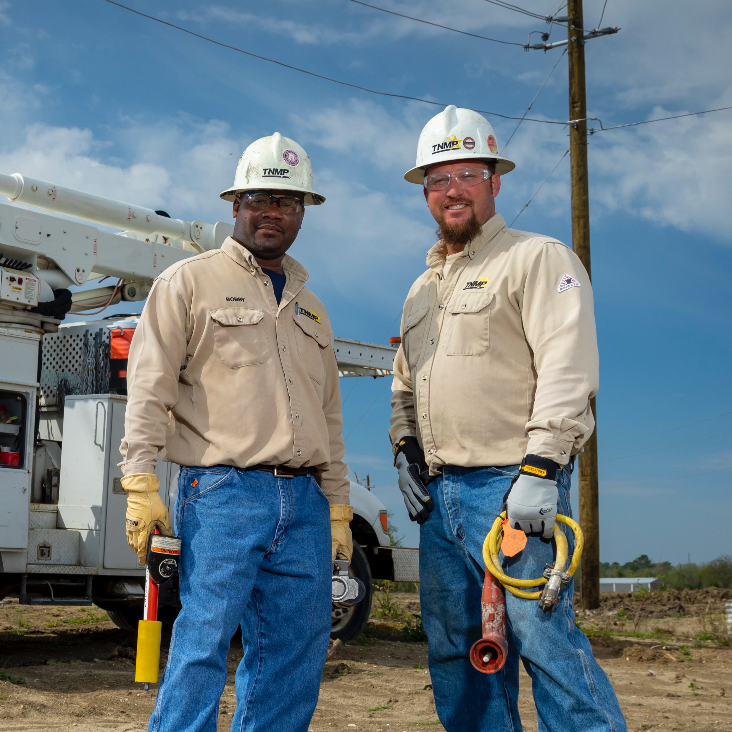
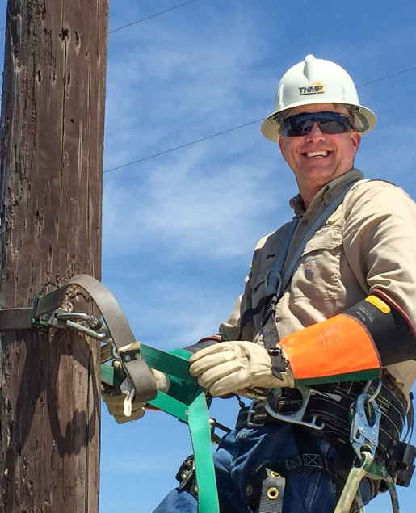


Questions?
Email questions to sara.yingling@tnmp.com

