Slide 1


Acquisition & Regulatory Updates
Stacy Whitehurst
Vice President of Regulatory Affairs

Slide 2

Acquisition & Regulatory Updates
          Acquisition of TXNM Energy & Subsidiaries
          Regulatory Updates

Slide 3


Acquisition of TXNM Energy & Subsidiaries
          Overview of the acquisition
          Regulatory processes for approval
          TNMP’s filing at the Public Utility Commission of Texas

Slide 4
Overview of the Acquisition
          Current corporate structure
          Proposed simplified corporate structure
TXNM Energy, Inc.
Texas-New Mexico Power Company
TNP Enterprises, Inc.
PNMR Services Company
Public Service Company of New Mexico
Troy ParentCo LLC
TXNM Energy, Inc.
Texas-New Mexico Power Company
TNP Enterprises, Inc.
PNMR Services Company
Public Service Company of New Mexico
TNPE 1, LLC

Slide 5
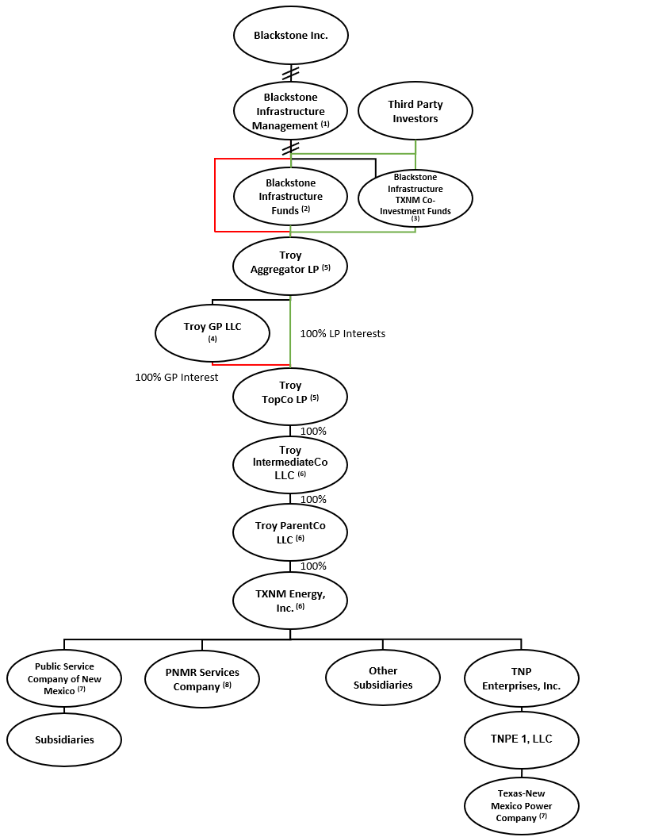
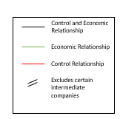
Detailed Organization Chart

Slide 6
          Regulatory processes for approval
          Regulatory processes for approval
            Approval by PUCT
            Approval by NMPRC
            Approval by NRC
            Approval by FERC
            Approval by FTC and DOJ (Hart-Scott Rodino)

Slide 7
TNMP’s filing at the Public Utility Commission of Texas
Transaction Structure
  The acquisition merges Troy Merger Sub with TXNM Energy, making TXNM a direct subsidiary of Troy.
Regulatory Approval Process
  The application is submitted to the Public Utility Commission of Texas under specific PURA statutes for approval.
Stakeholder Protections
  The transaction ensures employee protections, financial safeguards, and governance provisions remain intact post-acquisition.
Community and Public Interest Benefits
  The acquisition aims to benefit customers and communities, supporting public interest through regulatory commitments.
Notes:
This presentation outlines the joint application submitted by Texas-New Mexico Power Company (TNMP), Troy ParentCo LLC, and Blackstone Infrastructure Partners L.P. for regulatory approval of a proposed acquisition. The application is filed with the Public Utility Commission of Texas (PUC) and seeks approval under PURA §§ 14.101, 39.262, and 39.915. The transaction involves the merger of Troy Merger Sub with TXNM Energy, resulting in TXNM becoming a direct subsidiary of Troy. TNMP will remain a wholly owned subsidiary, with its operations and obligations continuing unchanged. The presentation will cover the transaction structure, customer and community benefits, employee protections, financial safeguards, governance provisions, regulatory commitments, and the public interest rationale supporting the application.

Slide 8

Customer & Community Benefits
Rate Credits: TNMP will provide a direct financial benefit to customers in the form of a rate credit of $35 million to be paid over 48 months following the closing of the Acquisition.
Economic Development: Troy will contribute $10 million in Economic Development funds over a period of 10 years to fund one or more of the following: job training, apprenticeships, or scholarships in utility-related areas of industry.
Charitable Giving: TNMP will maintain its historical level of charitable contributions, and it will make additional charitable contributions within TNMP’s service territory in the amount of $500,000 per year for a period of 10 years after the closing of the Acquisition, for a total commitment of $5 million.
Notes:
The proposed transaction offers substantial benefits to TNMP customers and the broader Texas community. These include a direct financial rate credit to customers, with the amount to be determined, distributed over three years. Blackstone Infrastructure Partners will contribute $10 million over ten years to support economic development initiatives such as job training, apprenticeships, and scholarships. Additionally, $5 million in charitable contributions will be made over ten years to support local communities. The transaction is expected to enhance TNMP’s access to capital and procurement efficiency, while retaining local control and management. These benefits are designed to provide both immediate and long-term value to customers and communities.

Slide 9
Employee & Workforce Protections
Job Security Commitment
  No involuntary workforce reductions or wage and benefit cuts for at least three years after transaction closing.
Collective Bargaining Adherence
  TNMP will honor all current collective bargaining agreements to protect employee rights and benefits.
Local Workforce Preservation
  Focus on retaining TNMP’s local workforce and operational independence to ensure quality service and community ties.
Notes:
TNMP employees are protected under the terms of the proposed transaction. There will be no involuntary workforce reductions or reductions in wages or benefits for at least three years following the closing. TNMP will continue to honor all current collective bargaining agreements. These commitments are aimed at maintaining workforce stability and ensuring that employees are supported throughout the transition. The application underscores the importance of preserving TNMP’s local workforce and operational independence, which are critical to maintaining high-quality service and community engagement.

Slide 10
Financial Protections & Ring-Fencing
Establishment of Special Purpose Entity
  A special purpose entity (SPECO) will hold TNMP equity to ensure dedicated focus on utility services.
Asset and Financial Separation
  TNMP’s assets won’t be used for affiliate benefit, maintaining separate books and credit ratings.
No Additional Debt or Cost Recovery
  TNMP will incur no new debt from the transaction and won’t recover transaction costs in rates.
Ring-Fencing to Protect Customers
  Ring-fencing measures preserve TNMP’s financial independence and shield customers from risks.
Notes:
The transaction includes comprehensive financial protections to insulate TNMP from risks associated with its parent companies and affiliates. A special purpose entity (SPECO) will be created to hold TNMP equity, ensuring that TNMP’s sole purpose remains the provision of transmission and distribution utility services. TNMP’s assets will not be pledged for affiliate benefit, and the company will maintain separate books, records, and credit ratings. No new debt related to the transaction will be incurred, and TNMP will not recover transaction costs or acquisition premiums in rates. These ring-fencing measures are designed to preserve TNMP’s financial independence and protect its customers from adverse financial impacts.

Slide 11
Governance & Oversight
Independent Board Composition
  TNMP’s board includes at least three independent directors, with two residing in Texas for local oversight.
Board Authority on Key Decisions
  The board oversees critical decisions including dividend policy, debt issuance, and capital expenditures.
Ensuring Compliance and Focus
  Independent directors ensure compliance with ring-fencing provisions and prioritize TNMP’s Texas customers.
Notes:
TNMP’s governance structure will be enhanced to ensure strong local oversight and independence. The board will include at least three independent directors, two of whom will be Texas residents. The board will have authority over key decisions such as dividend policy, debt issuance, and capital expenditures. Independent directors will oversee compliance with ring-fencing provisions and ensure decisions are made in the best interest of TNMP. These governance commitments are designed to maintain TNMP’s focus on serving Texas customers and to prevent undue influence from parent companies or affiliates.

Slide 12
Regulatory Commitments
Regulatory Oversight
  TNMP will remain subject to the Public Utility Commission of Texas ensuring ongoing regulatory oversight and compliance.
Annual Compliance Reporting
  TNMP will file annual compliance reports for five years, maintaining transparency and regulatory accountability.
Governance and Approval
  Governance documents will be amended and future changes require Commission approval to uphold regulatory commitments.
Jurisdictional Restrictions
  TNMP will not build assets outside ERCOT or impair Commission jurisdiction without prior approval.
Notes:
TNMP will remain under the jurisdiction of the Public Utility Commission of Texas. The company will file annual compliance reports for five years following the transaction and provide access to books and records for regulatory review. Governance documents will be amended to reflect regulatory commitments, and any future changes will require Commission approval. TNMP will not build assets outside ERCOT or take actions that impair the Commission’s jurisdiction without prior approval. These commitments ensure ongoing transparency, accountability, and adherence to Texas regulatory standards.

Slide 13
Regulatory Updates
          Rate Recovery filings

Slide 14
Cost Recovery
General Rate Case
  180-day schedule after filing.
  Highly contested.
  Significant number of resources from both TNMP & PNMR Services Company and several million dollars worth of legal and consultants.
  Intervenors include:
    Commission Staff
    Office of Public Utility Counsel (OPUC)
    REPs
    Municipalities
    Industrials
Interim Transmission Cost of Service Case (TCOS)
  Typically on a 60-day schedule after filing.
  Several resources from TNMP & PNMR Service Company with no legal costs.
  Intervenors include:
    Commission Staff
Transmission Cost Recovery Factor (TCRF)
  Typically on a 90-day schedule after filing with rates effective March 1st and September 1st.
  Very limited scope.

Slide 15
Cost Recovery (cont.)
Distribution Cost Recovery Factor (DCRF)
  Previously on a 150-day schedule with rates effective September 1st. Will now operate with a timeline similar to Interim TCOS and utilities will be allowed to file two DCRF updates each year.
  PUCT rulemaking is currently ongoing.
  Limited scope.
  Several resources from TNMP & PNMR Services Company and several hundred thousand dollars worth of legal.
  Intervenors include:
    Commission Staff
    REPs
    Municipalities
    Industrials
Energy Efficiency Cost Recovery Factor (EECRF)
  Typically on a 150-day schedule after filing with rates effective March 1st of the following year.
  Extremely limited scope.
  Several resources from TNMP & PNMR Services Company and several thousand dollars worth of legal.
  Intervenors include:
    Commission Staff
    REPs
    Municipalities

Slide 16
Cost Recovery (cont.)
HB5247 - Relating to an alternative capital recovery process for certain utilities
Signed into law on June 20, 2025, by Governor Greg Abbott; effective immediately
Adds §36.216 to the Public Utility Regulatory Act (PURA)
Applies to electric utilities constructing transmission for the Permian Basin reliability plan
Eligible utilities: those with capital expenditures exceeding 300% of annual depreciation in a calendar year
Allows election to file a single annual proceeding to adjust nonfuel rates system-wide, reflecting changes in transmission and distribution invested capital
Replaces adjustments to retail and wholesale rates under other interim mechanisms

Slide 17


Questions?

