Slide 1
TNMP REP Meeting
Sara Yingling
TNMP Communications

Slide 2
TNMP Website Redesign
Project Status – Sept 25, 2024

Slide 3
Project Goals
Make website user-friendly/easier to use
Eliminate redundancy
Help users find important information quickly
Make website ADA compliant
Combine TNMP.com with TNMP Energy Efficiency website
Excellent support for mobile devices

Slide 4
Project Goals
“What must the primary audience be able to find / do quickly and easily ?”
Find TNMP’s outage map to report outages
Report on streetlight issues
REP & commercial customers information
Learn about vegetation management
Learn about energy efficiency and options

Slide 5
Project Goals
Current Site Problems:
We hear customer complaints on social media about difficulty reporting outages or streetlight issues.
Cities, elected officials, and OEM staff feel the site is frustrating to use (as an end-user) due to a multitude of clicking.
“It’s like going down a rabbit hole to find what you are needing.”
Outdated and needs to be user-friendly like our competitors’ sites.

Slide 6
Site Analytics – Device Use
Upshot: site is viewed on a mobile device 3 times out of 4, so emphasis should be on mobile design and usability
Data from the current site from the past 12 months
Platform | Users | Percent
Mobile | 219,626 | 73%
Desktop | 76,424 | 26%
Tablet | 2,996 | 1%

Slide 7
Site Analytics – Pages
Upshot: Power Outage pages are far and away the most popular pages and the Contact Us page is too confusing
Data from the current site from the past 12 months
Landing Page | Views | Time on Page (sec)
Power Outages Hazards | 260K | 13
Home Page | 76K | 47
Power Outage Map | 56K | 13
Contact Us | 19K | 49
Outage Notification | 18K | 26

Slide 8
Initial Designs – Home Page (top)

Slide 9
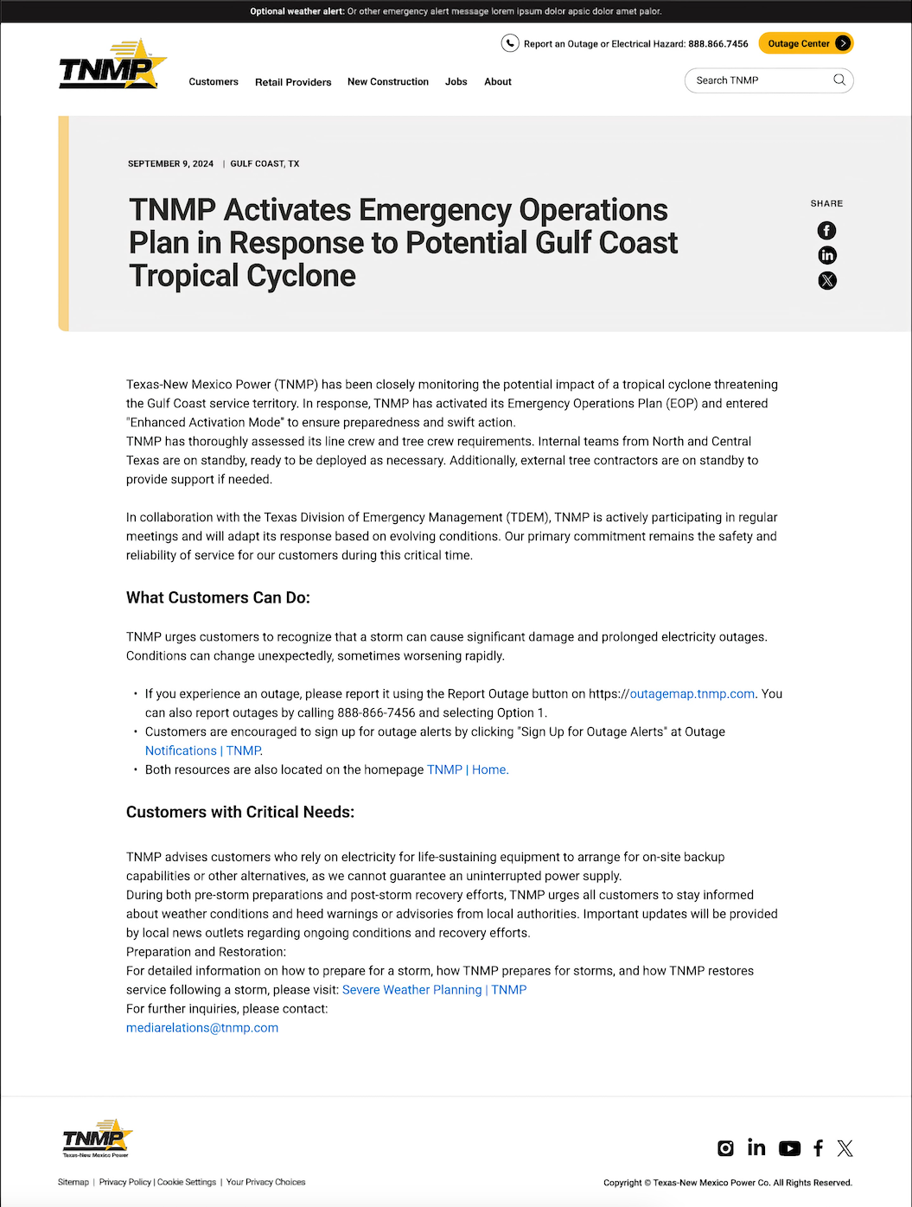
Initial Designs – Press Room and General Pages

Slide 10
Projected Timeline
Aug 12 - Aug 23 Information architecture, final requirements clarification Completed
Aug 12 - Aug 16 Initial development site and dev pipeline creation, Completed initial modules and configuration
Aug 19 - Aug 30 Content migration (raw, as is) Completed
Aug 26 - Sep 6 Wire-framing / lo-fidelity design of major page styles, Completed mobile and desktop
Sep 9 - Sep 27 High-fidelity design, mobile and desktop (first pass) In Progress
Sep 30 - Oct 12 Design review, revisions, first mobile then desktop On Schedule
Aug 26 - Dec 6 Site functionality / individual page development In Progress

Slide 11
Projected Timeline (cont)
Oct 7 - Nov 1 Theming – mobile In Progress
Nov 4 - Dec 6 Theming – desktop Planned
Oct / Nov Security requests, Microsoft Authenticator support Added, Planned
(Testing / Review / Rework : ongoing from when site pages are ready for review)
Dec 9 Alpha (general idea of site is complete, theming and most Planned pages are complete, some work still ongoing)
Jan 13 Beta (site in final form, just doing final testing, tweaks, and Planned platform updates)
Jan 29 Release On Time
Website Development is currently on-time and on-budget.

