Slide 1
TNMP REP Meeting
Chris Gerety
Vice President – Tech Svc and System Reliability

Slide 2
Tech Svc and Sys Reliability
Distribution Engineering
System Engineering
Transmission Engineering/PM/Construction
Transmission Planning
Substation Eng/PM/Construction/Field Operation
System Protection Eng/PM/Const/Field Operation
Metering Eng/PM/Field Operations
System Operations
Real Time Operations – T&D
Field Telecommunications Eng/PM/Const/Field Operations

Slide 3
Tech Svc and Sys Reliability
Distribution Engineering
New Service Portal – Power Clerk
DGR
21 In-service
9 in Construction
6 in Study
GIS
Modern Platform to make work more productive and reduce database errors
Customer Requests | Q2 2024 | Q1 2024 | Q4 2023 | Q3 2023 | Q2 2023 | Q1 2023 | Q4 2022 | Q3 2022 | Q2 2022 | Q1 2022
West Texas | 116 | 105 | 63 | 88 | 86 | 102 | 84 | 78 | 96 | 120
Total Texas | 623 | 579 | 475 | 570 | 549 | 507 | 376 | 468 | 228 | 195

Slide 4
Resiliency Plan
System Hardening
Hardened above ground
Undergrounding
Flood Prevention
System Modernization
Substation Relays
Scada connected reclosers
Trip Savers
VM
Cycle Based
Wildfire
Asset Protection/Situational Awareness/Ignition Prevention
Cyber Security/Physical Security

Slide 5
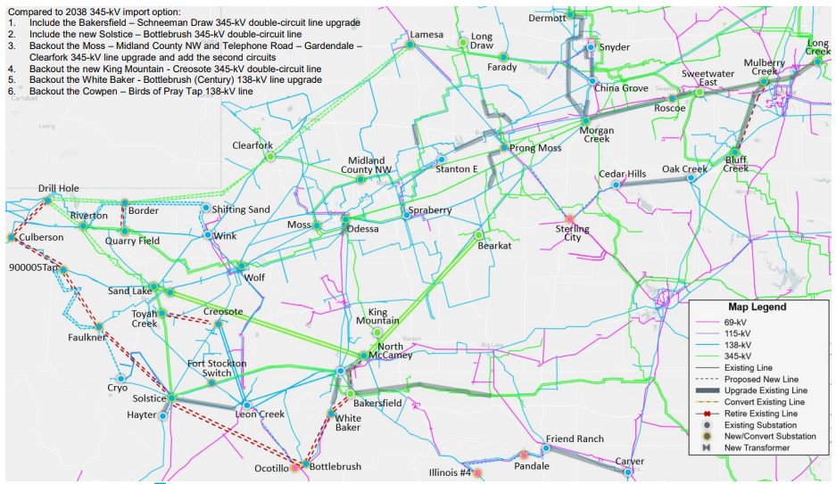
Tech Svc and Sys Reliability
System Engineering – Permian Basin Project

Slide 6
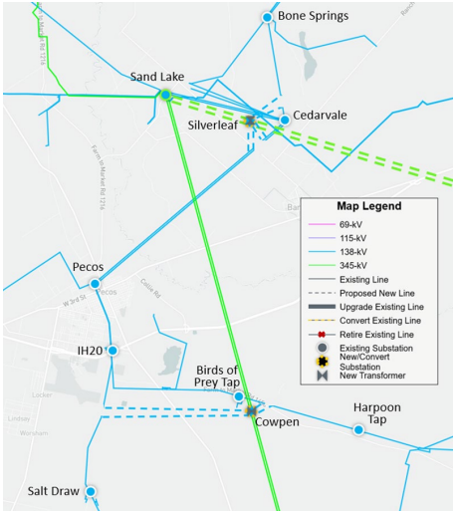
Tech Svc and Sys Reliability
System Engineering – Silverleaf/Cowpen Project

Slide 7
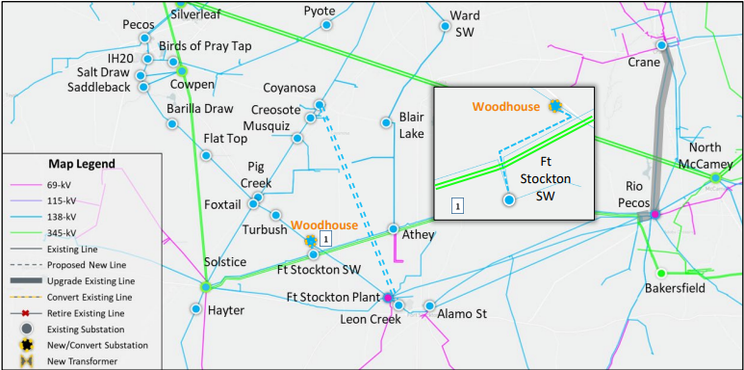
Tech Svc and Sys Reliability
System Engineering – Pecos County Project

Slide 8
Tech Svc and Sys Reliability
AMI Updates – RIVA Gen 5 – RF Mesh Network
Installations by Year
2022 ~195K
2023 ~30K
2024 ~10K
2025 ~10K
2026 ~15K
2027 ~15K
Mesh Network Design
Full system design complete
Allows for replacement of any meter with a mesh meter
RIVA Cell based meter pending

Slide 9
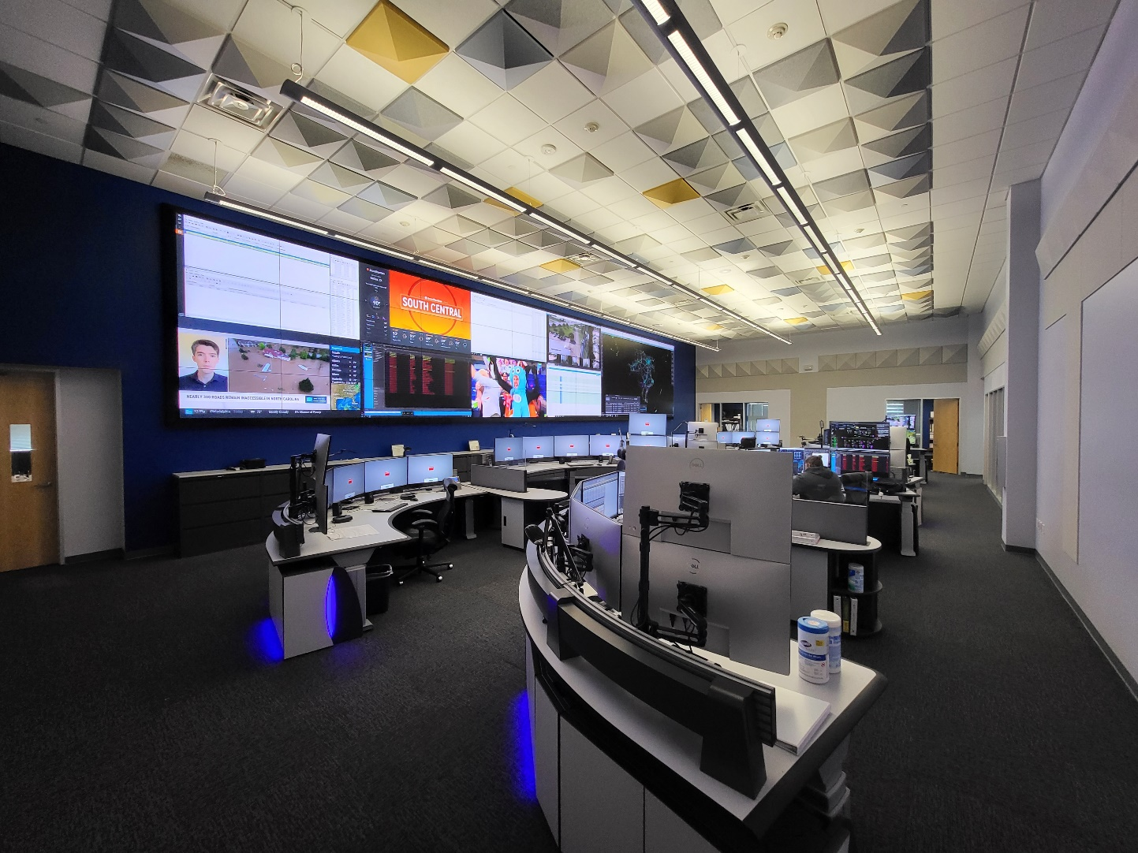
System Operation
Control Center Refresh

Slide 10
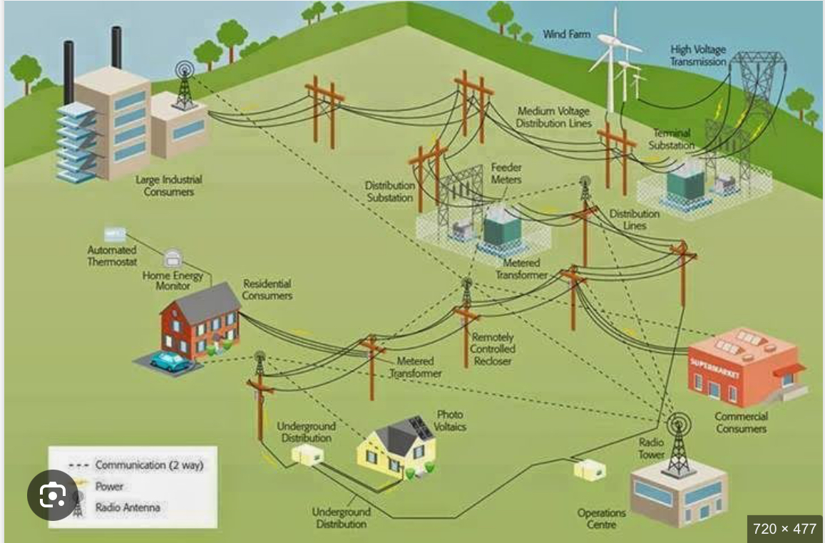
System Operation
Field Area Network

