Slide 1
Regulatory Update
Stacy Whitehurst
Vice President of Regulatory Affairs

Slide 2
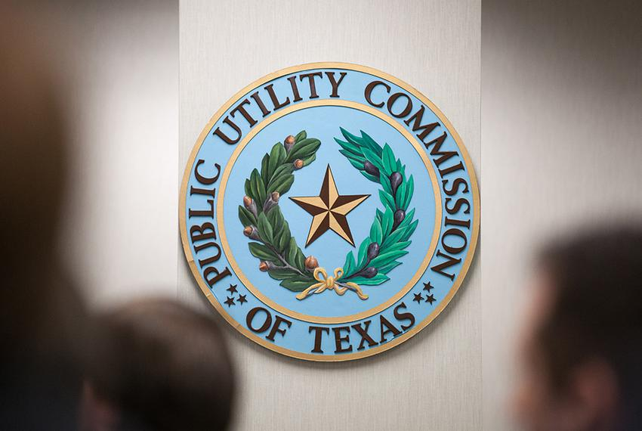
Agenda
Overview of the Public Utility Commission of Texas
Rate recovery mechanisms
Current projects and proceedings

Slide 3
The Public Utility Commission of Texas
Founded in 1976, the PUCT regulates the state’s electric, telecommunication, and water and sewer utilities, implements respective legislation, and offers customer assistance in resolving consumer complaints.
Oversees the competitive market and compliance enforcement of statutes and rules.
Governed by five Commissioners who are appointed by the Governor to six-year, staggered terms. The Governor also appoints a presiding officer (chair).

Slide 4
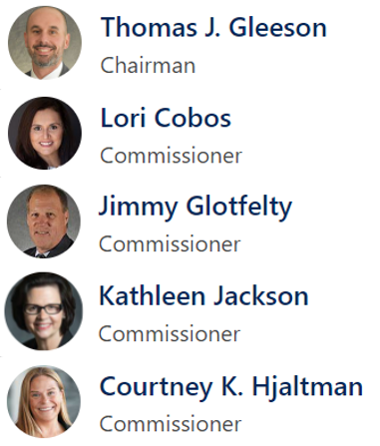
The Public Utility Commission of Texas
From Three to Five
Governor Greg Abbott appointed Thomas Gleeson to serve as Chairman of the PUCT on January 19, 2024.
Lori Cobos was appointed to serve as a Commissioner on June 17, 2021.
Jimmy Glotfelty was appointed to serve as a Commissioner on August 6, 2021.
Kathleen Jackson was appointed to serve as a Commissioner on August 5, 2022.
Courtney Hjaltman was appointed to serve as a Commissioner on June 24, 2024.

Slide 5
Cost Recovery
General Rate Case
180-day schedule after filing.
Highly contested.
Significant number of resources from both TNMP & PNMR Services Company and several million dollars worth of legal and consultants.
Intervenors include:
Commission Staff
Office of Public Utility Counsel (OPUC)
REPs
Municipalities
Industrials
Interim Transmission Cost of Service Case (TCOS)
Typically on a 60-day schedule after filing.
Several resources from TNMP & PNMR Service Company with no legal costs.
Intervenors include:
Commission Staff
Transmission Cost Recovery Factor (TCRF)
Typically on a 90-day schedule after filing with rates effective March 1st and September 1st.
Very limited scope.

Slide 6
Cost Recovery (cont.)
Distribution Cost Recovery Factor (DCRF)
Previously on a 150-day schedule with rates effective September 1st. Will now operate with a timeline similar to Interim TCOS and utilities will be allowed to file two DCRF updates each year.
PUCT rulemaking is currently ongoing.
Limited scope.
Several resources from TNMP & PNMR Services Company and several hundred thousand dollars worth of legal.
Intervenors include:
Commission Staff
REPs
Municipalities
Industrials
Energy Efficiency Cost Recovery Factor (EECRF)
Typically on a 150-day schedule after filing with rates effective March 1st of the following year.
Extremely limited scope.
Several resources from TNMP & PNMR Services Company and several thousand dollars worth of legal.
Intervenors include:
Commission Staff
REPs
Municipalities

Slide 7
PUCT Rulemakings & Projects
Project No. 53404 - Temporary Emergency Electric Energy Facilities And Long Lead-time Facilities
These proposed rules will allow transmission and distribution utilities to use temporary equipment and permanent transmission and distribution facilities to help restore power to consumers affected by significant power outages. These proposed rules will also allow utilities to recover the cost of using temporary and permanent facilities through customer rates. This rulemaking implements HB 2483 from the 87th Texas Legislature and HB 1500 from the 88th Texas Legislature.
Project No. 56987 - Electric Utility Outage Tracker and Hazardous Condition Reporting
Requires electric utilities to maintain an online outage tracker. The amendment will also require electric utilities, municipally owned utilities, and co-ops to create a process to receive information from the Commission and other state agencies concerning potentially hazardous conditions.
Project No. 56898 - Provision Of Emergency Contact Information To Transmission And Distribution Utilities By Retail Electric Providers
Requires retail electric providers to share customer emergency contact information with electric utilities, so that electric utilities can communicate outage information to customers during energy emergencies.

Slide 8
PUCT Rulemakings & Projects
Project No. 56962 - Registration of Virtual Currency Mining Facilities
Establishes a process for the registration of virtual currency mining facilities in the ERCOT power region that demand a large load of interruptible power.
Project No. 56966 Goal for Average Total Residential Load Reduction
Proposes creating a goal and a program, through retail electric providers, for electric customers who use a smart appliances or devices to reduce electricity usage during a peak demand period in ERCOT.
Project No. 55249 - Regional Transmission Reliability Plans (RTP)
As part of the ongoing 2024 RTP, ERCOT is evaluating the benefits that EHV facilities may provide to the ERCOT System and expects to provide more detail in its RTP study report.
Project No. 54233 - Technical Requirements and Interconnection Processes for Distributed Energy Resources (DERs)
Revise the technical and operational requirements and the interconnection process for distribution resources operating in parallel to the distribution system.
Project No. 54224 - Cost Recovery for Service to Distributed Energy Resources (DERs)
ERCOT wide solution on potential DER interconnection allowance and monthly charges
Project No. 56199 - Review of Distribution Cost Recovery Factor
Reconcile the existing rule with 2023 Public Utility Regulatory Act changes

Slide 9
Questions

