Slide 1
REP Portal Updates
Andrea Couch
Manager – REP Relations & Billing

Slide 2
Portal Updates
Add consumption graphs
3 month & 12 month
Add Quick Links
SMT
TNMP Website
Outage Option Links on Toolbar
Report Outage
View Outage Map

Slide 3
Portal Updates
Premise Search Results limited view
Responsive design has limitations due to display for all devices, including mobile
Adjust/decrease column width to provide full view of tab data
Affects all tabs except Premise Information

Slide 4
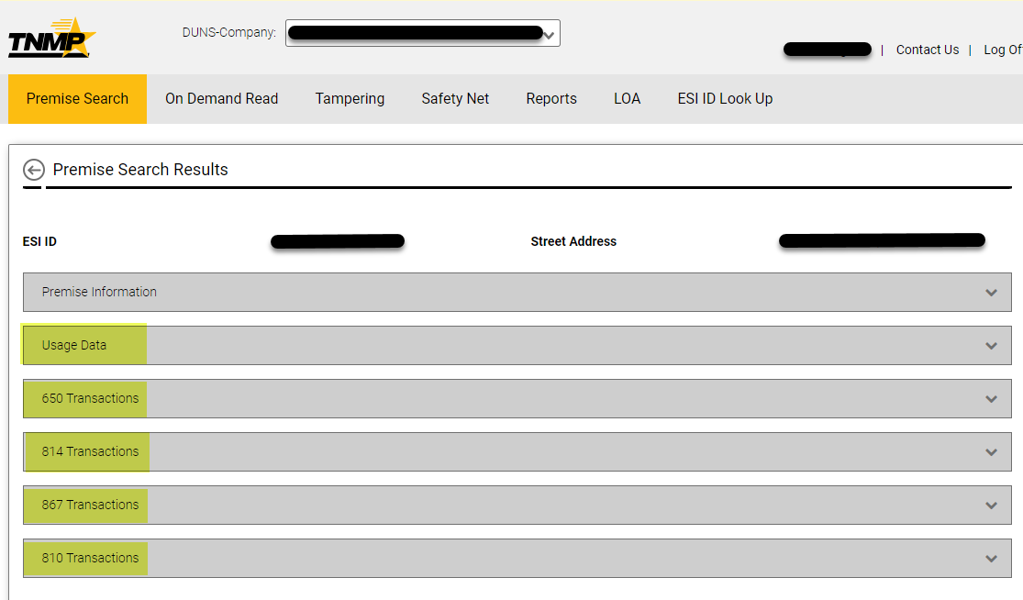
Portal Updates

Slide 5
Portal Updates

Slide 6
Portal Updates
Remove validations from LOA process
Currently validate ESI ID, Street Name, City, State, Zip & Last Name
Only validate ESI ID & Last Name
LOA & SafetyNet process updated to allow a manual entry or upload a spreadsheet

Slide 7
Portal Updates

Slide 8
Portal Updates

Slide 9
Portal Updates - Timeline
Timeline to implement updates
LOA Improvements
December 2024
Premise Search Limited View
December 2024
SafetyNet Improvements
January 2025
Consumption Graphs
February 2025

Slide 10
Portal Updates - Chat
Addition of Chat functionality on portal
Available
Monday – Friday, 8:00 AM – 5:00 PM
Implement December 2024
Testing and training currently in process

Slide 11
Portal Updates - Chat

Slide 12
Portal Updates - Chat

Slide 13
Portal Updates - Chat

Slide 14
Portal Updates - Chat

Slide 15
Portal Updates
Questions?

