Slide 1
Texas Legislative Update
Ben Utley
Government Relations

Slide 2
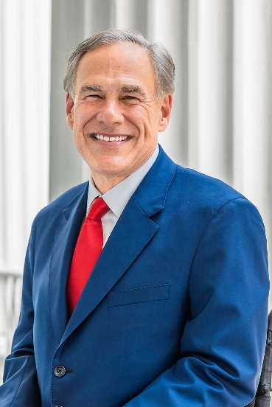
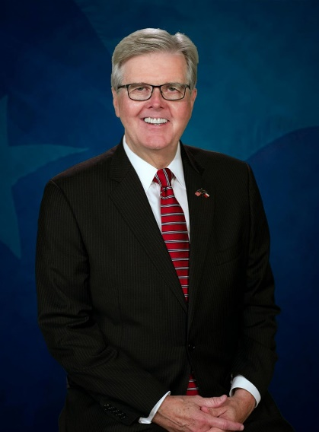
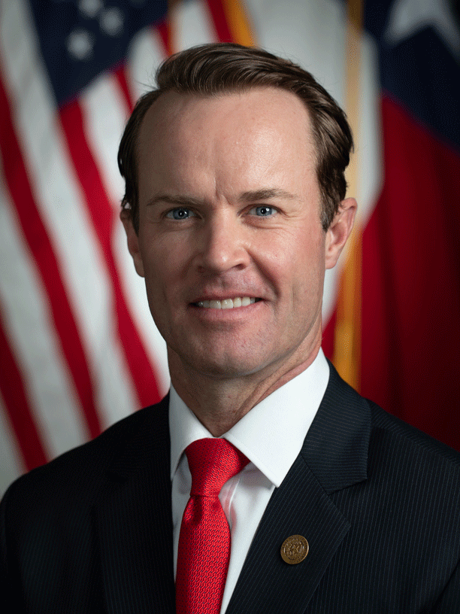
Texas Leadership and Legislature
Gov. Greg Abbott
Abbott was elected in 2014 and is entering his sixth legislative session as Governor.
Lt. Gov. Dan Patrick
Patrick was elected in 2014 and is entering his sixth legislative session as Lt. Governor.
Speaker Dade Phelan
Phelan was elected to the Texas House in 2016 and will be entering his fifth legislative session. He has served two sessions as Speaker of the House.

Slide 3
Range of Potential Outcomes in Texas Senate and House
31 Senators (19 Republicans and 12 Democrats)
15 Senators are up for re-election to four year terms
10 contested races in November
Six incumbent Republicans
Two incumbent Democrats
Two open Seats
150 Representatives (87 Republicans and 63 Democrats)
All House members are up for election every two years
House will have at least 32 new members due to 16 retirements and 16 incumbent losses in primaries
90 contested races in November
46 incumbent Republicans
21 incumbent Democrats
23 races without incumbents

Slide 4
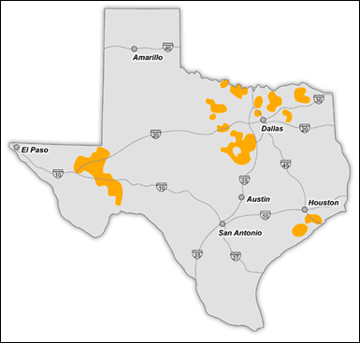
TNMP Service Territory
TNMP service territory includes portions of 41 districts
13 Senators
At least one new Senator in 2025
28 Representatives
At least 10 new Representatives in 2025

Slide 5
Next Session: Top Electric Industry Issues Expected in 2025
89th Legislative Session
Begins Tuesday, January 14, 2025
Adjourns Sine Die June 2, 2025
Race for Speaker
Speaker Phelan is facing opposition as Speaker of the House
Six Republicans announced for speaker before coalescing behind one candidate opposing Speaker Phelan, and one Democrat has announced
Key issue is a debate of whether Democrats should be given chairmanships
Key Topics
Wildfire and hurricane preparation and response
Rising insurance premiums
Market design, emerging technologies, energy efficiency, and others

Slide 6
Pop Quiz
What is the key difference in how the Speaker of the House and the Lt. Governor are elected?

