Slide 1
Hurricane Beryl – TNMP’s Experience & Lessons Learned
Keith Nix
Vice President - Operations

Slide 2
The Setup.....
7/1 – 7/4: Monitoring of weather service has been ongoing since Beryl projected to hit Gulf of Mexico. Original projections show Beryl hitting south of service territory towards Mexico. Worst case scenario is Corpus Christi (I go back to my holiday Beers & BBQ!!).
7/4: Monitoring continues. Slight adjustment eastward begins, hitting south Texas coast but still only as far east as Corpus Christi. Indications through Texas Department of Emergency Management (TDEM) calls is that AEP has started making preparations based upon Corpus Christi projections. TNMP decides to continue monitoring.
7/5 (early afternoon): Adjustment east is made again during TDEM call. Beginning to approach TNMP furthest west service territory around West Columbia/Sweeny area. Freeport is projected for landfall now, a little further east than Corpus. TNMP evaluates weather service projections that agree with landfall still just outside of TNMP service territory.

Slide 3
The Setup (cont’d).....
7/5 (early afternoon): Adjustment east is made again during TDEM call. Beginning to approach TNMP furthest west service territory around West Columbia/Sweeny area. Freeport is projected for landfall now, a little further east than Corpus. TNMP evaluates weather service projections that agree with landfall still just outside of TNMP service territory.
7/5 (evening): Adjustment further east made again, bringing Brazoria County, West Columbia, Angleton areas into cone. Texas City/Friendswood still outside of projection according to weather service and NOAA, however local resources are receiving reports of projected wind speed of 100 MPH+ for Texas City. THIS GETS MY ATTENTION!!
7/6 (1:30 PM call): EOP Executive Committee meets and confirms forecast. Activation of EOP is eminent but still seeing conflicting wind projections and location. Discussion about sending DOC/SOC operators to Lewisville is held but still not seeing winds above 58 MPH so decision is made to hold firm until Sunday call. Assessment of initial available resources internally is made at this time.

Slide 4
The Storm.....
7/7 (morning): after seeing new forecast Emergency Operations Manager contacts Director of SOC and decision made to send SOC/DOC operators to Lewisville backup operations site (BSOC transmission and distribution system operators). Plan is executed and Operators leave at 12:00 PM for late evening arrival. Also Emergency Operations Manager reaches out to NTX & CTX Directors and sends crews down to Gulf Coast for arrival on Sunday night. Storm predicted to arrive at 1 AM to 10:00 AM Monday morning, 7/8.
Multiple calls held activating Emergency Operations Plan and preparing to obtain Mutual Assistance from other utilities that were not projected to be impacted.
7/8 (early morning): Storm arrives. TNMP loses 60 distribution circuits, 8 transmission circuits. Additional resources are requested by TNMP (250 line, 150 VM is initial request). External damage assessors are requested from Utility Power (25 FTE’s). Request for Tuesday afternoon/Wednesday morning arrival. 5 of 8 transmission circuits are restored, Brazoria County is bullseye and has 3 transmission circuits locked out. Restoration and evaluation efforts begin by TNMP personnel and external crews as per EOP.

Slide 5
The Impacts and Response....
60 to 95 MPH winds experienced with heavy rain and debris (Cat 1)
Approximately 117,000 customers impacted during storm. Hardest hit area was as expected (Brazoria County areas of Brazoria, West Columbia, Alvin) but all Gulf areas impacted
Over 50% of customers were restored within 24 hours. All transmission circuits restored by Tuesday, 7/9. Last customers that could take service restored on Wednesday, 7/17.
No impacts to large industrial customers served by transmission
Event is mostly related to trees falling into TNMP lines. 481 pole failures in total (out of 103k in the combined areas, less than 1%)
Mutual Assistance is activated – TNMP brings in over 863 line personnel and over 761 Vegetation Management personnel in addition to our own personnel
TNMP sets up multiple staging areas to provide materials, food and fuel to provide for all arriving and internal crews
Work is done in 16 hour shifts with internal TNMP trouble crews providing services during graveyard shift.

Slide 6
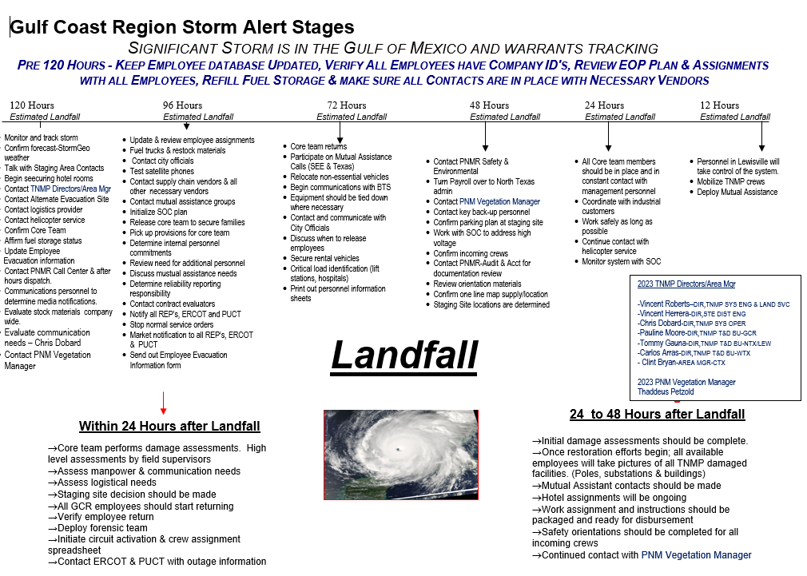
How Do We Know What to Do?

Slide 7
Lessons Learned
Resource Requests – Vegetation should come before line resources to clear lines before restoration work can begin.
Customers are paying attention like never before!! Good info on outage maps is critical!
Communications can be spotty – do not count on cell phones or internet to be solid and that impacts customer interactions
Key to get ahead of customer and local authority communications. Being proactive helps.
Be flexible in your plans – every response and storm is different and be prepared to make changes “on the fly”
Drills and exercises are key in the execution of your plan.
Communicate with customers the need for them to make preparations for long term outage conditions. Many customers took for granted that because storm was only a Cat 1 and no evacuation was issued that things would be just fine immediately after storm passed.....NOT TRUE!!!

Slide 8
QUESTIONS??

